Slide 1
Radio Occultation From POD to Bending Angle
Bin Zhang

Slide 2
Statement of Work
Leo Precise Orbit Determination
  Understand and run Bernese Software
  Understand errors in orbital interpolation and coordinate transformation
  Leo Receiver Clock error estimation
  Understand LEO attitude (Quaternions , ECEF/ECI coordinates, Space Craft/Instrument )
RO Event Determination
  Readers for GPS observations as phase and pseudo range.
  Determine observation intervals to separate each RO event in both OCC and POD antenna observations.
  SNR check, phase scaling factor, cycle slip removal, phase model calculation
  Pair RO event from OCC antenna with event from POD antenna (1Hz or high rate) for single differencing.
Excess Phase Model
  For each RO event
  Calculate atmospheric path delay (excess phase) from raw observation
    Contributions from LEO/GNSS range, clock errors of Leo and GNSS, general relativity, phase windup etc.
  Determine excess doppler shift
  Cycle slip and Navigation Data Modulation removal.
Bending Angle/refractivity Calculation
  Using ROPP to do the integration
  Using ROPP for internal bit correation to remove cycle slips
  Decodeing GPS/GlONASS Navigation Bit time series
RO data validation, inter-mission/inter center comparison, Climate monitoring using RO datasets

Slide 3
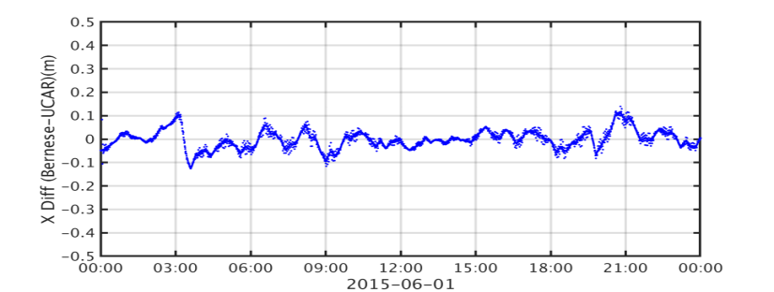
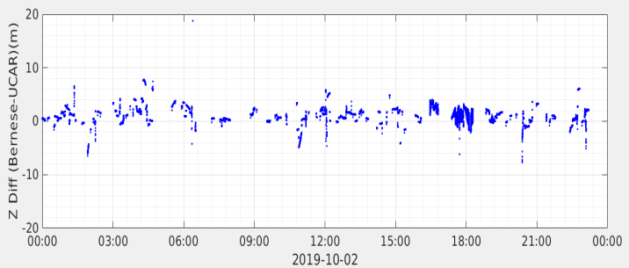
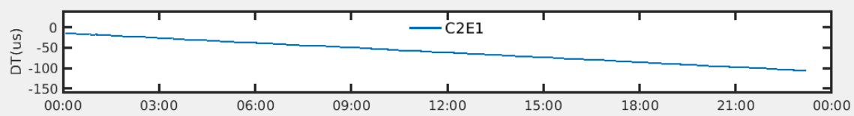
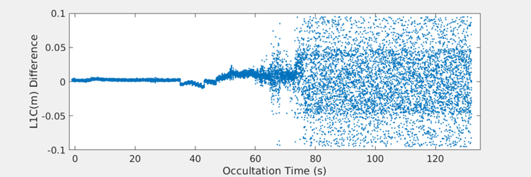
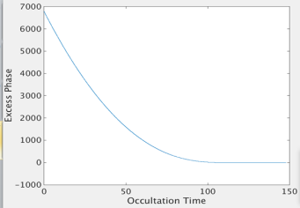
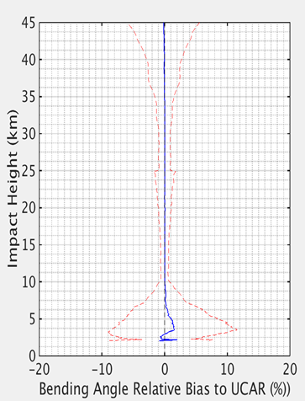
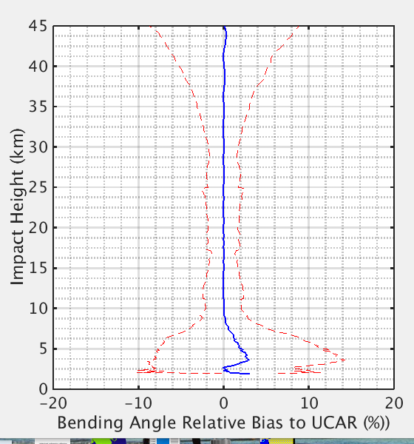

Current and Important Work
1. Bernese Software for POD and CLOCK error estimation
Bernese POD compared with UCAR
POD in X(ECEF) direction for COSMIC-1
$$×$$
Bernese Orbit Kinetic Solution compared
with UCAR POD in X for COSMIC-2
Bernese COSMIC-2 CLOCK ERROR
2. Excess phase model/calculation
Cycle Slip Detection in phase
C2 Excess
phase
(GeoOptics)
C-1
C-2/L1
3. ROPP Bending Angle/Refractivity calculation
4. Validation/Calibration RO Products from different missions

Slide 4
Papers/Presentations
Presentations
  Zhang,B., S. Ho, X.Shao and C.Cao, Using Radio Occultation observations to detect ATMS brightness temperature bias, International Radio Occultation Working Group (IROWG), Helsingør, Denmark, 09/19-09/25,2019 (poster).
  Cao,C., E.M. Lynch, B. Zhang, T. Reale and Y. Bai. GNSS-RO Data Quality Assurance for Operational Weather Forecast Using the Integrated Calibration, Verification and Validation System, AMS, Phoenix, AZ, 2019 (poster)
  Zhang, B., E. M. Lynch, C. Cao, X. Shao, and L. Lin. Recent Results in the Validation and Monitoring of COSMIC Radio Occultation Performance, AMS, Phoenix, AZ, 2019 (Talk)
  Zhang, B., SP Ho, X Shao and C Cao. Error Assessments in the GNSS Radio Occultation Excess Phase/Bending Angle Calculation, AMS, boston, MA, 2020 (talk)
Papers (to be)
  RO L1a to L1B processing
  ATMS/RO inter-comparison (?)

