Slide 1
Error Assessments in the GNSS Radio Occultation Excess Phase/Bending Angle Calculation
Bin Zhang¹, Shu-peng Ho²,Xi Shao¹ and
Changyong Cao²
¹CISESS/ESSIC, University of Maryland, College Park, USA
² NOAA/STAR, College Park, USA
Jan. 14, 2019
AMS Annual Meeting, Boston

Slide 2
OUTLINE
Radio Occultation background and research goal
RO Excess Phase Calculation and error quantification
RO Bending Angle Experiments using ROPP
Summary

Slide 3
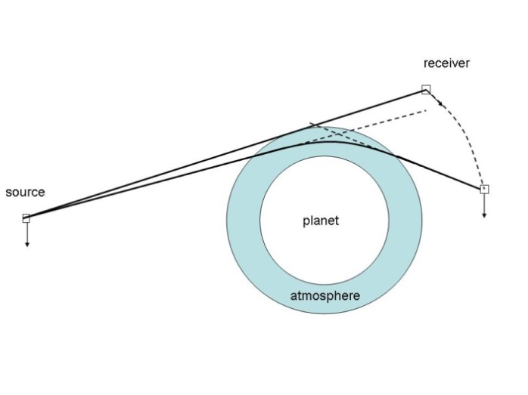
GNSS Radio Occultation Introduction
GNSS RO Receivers
Slim designed, can be on the small satellites or legacy satellites.
Similar to car GPS receiver, with more bands (L1/L2 etc) and stable clocks.
Multiple receivers (POD (zenith view) vs. OCC (limb view))
Record GNSS Microwave signal phase and time delay.
Radio Occultation Technique
Derive the GNSS signal path delay, the excess phase.
Derive the bending angle of the ray path
Inverse the atmosphere refractivity, temperature and water vapor
RO derived bending angle/refractivity has been used in NWP as “bias anchor”
no need for bias correction before data assimilation.
COSMIC-1 data has been assimilated into GFS since 2007.
RO data have fine vertical resolution (~100m).
RO observations have observation impact among top 5.
https://en.wikipedia.org/wiki/Radio_occultation

Slide 4
Research Goals
NOAA/STAR recently developed RO Cal/Val System for monitoring the quality of data products for COSMIC-2, Metop-C and other RO missions.
One of the important issues in data quality check is to understand the error sources in the data processing of different levels.
The RO derived bending angle profiles often have bias from different processing centers/different missions.
RO data processing from raw observations to Bending Angle is a new capability that needs to be developed onsite.
To establish the (Re)processing procedure from raw RO observations (carrier phase and time delay) to bending angle to understand processing steps.
To understand the error source, magnitude, and their propagation model errors in the processing products.
In this study, we reprocess the COSMIC-1 data and compare with UCAR results.

Slide 5
RO Processing Procedure with COSMIC-1 data
Raw BlackJet
Level0 Data Reader
Level 0
Antenna
Parameters
LEO Attitude
0.1Hz
Position
rinex
50Hz
Occulting (opngps)
SAT Health Status
Level 1a
IGS/CODE GNSS Data
Excess Phase Model
(Bash, matlab)
ECEF(ITRF)/ECI(J2000,TOD)
Interpolation (C/Matlab)
POD (Bernese)
GPS/LEO POS/VEL/CLK
Excess Phase; GPS/LEO POS/VEL
SNRs, Phase model
Level 1b
GPS Navigation Bit (GFZ)
Bending Angle; Impact Height
ROPP/STAR Version
Dry/Wet Temperature
Refractivity
Level 2 (follow UCAR convention)

Slide 6
POD Error Quantification
LEO Precise Orbit Determination is different from objects on ground
More affected by gravity anomaly than MEO satellites
Can not achieve high accuracy from kinematic solution
LEO mass center orbit determination needs (reduced) dynamic models for least square analysis.
Differencing with ground station receivers are more accurate but very computational cost.
Attitude control may introduce errors
Bernese Software Configuration (test for COSMIC-1)
Antenna parameters are needed.
Offsets, PCVs, Boresight Vector etc (Cheinway Huang et al. 2009)
RINEX Observation files and attitude files (from UCAR/CDAAC)
IGS GNSS Orbit and Clock solution, Earth Orientation
POD results
LEO mass center X/Y/Z in ECEF coordinates
30 seconds (or high resolution) LEO/GNSS clock errors.

Slide 7
Bernese Output POD Compared with UCAR (COSMIC/FM-1)
X
X
V_{X}
Y
Y
V_{Y}
Z
Z
V_{Z}
LEO POD X/Y/Z difference generally with 10cm difference, as LEO POD requirements for COSMIC is 10 cm.
X/Y/Z Velocity difference generally within 0.1mm/s difference, as LEO POD Velocity uncertainty requirements: 0.1mm/s in 3D rms.

Slide 8
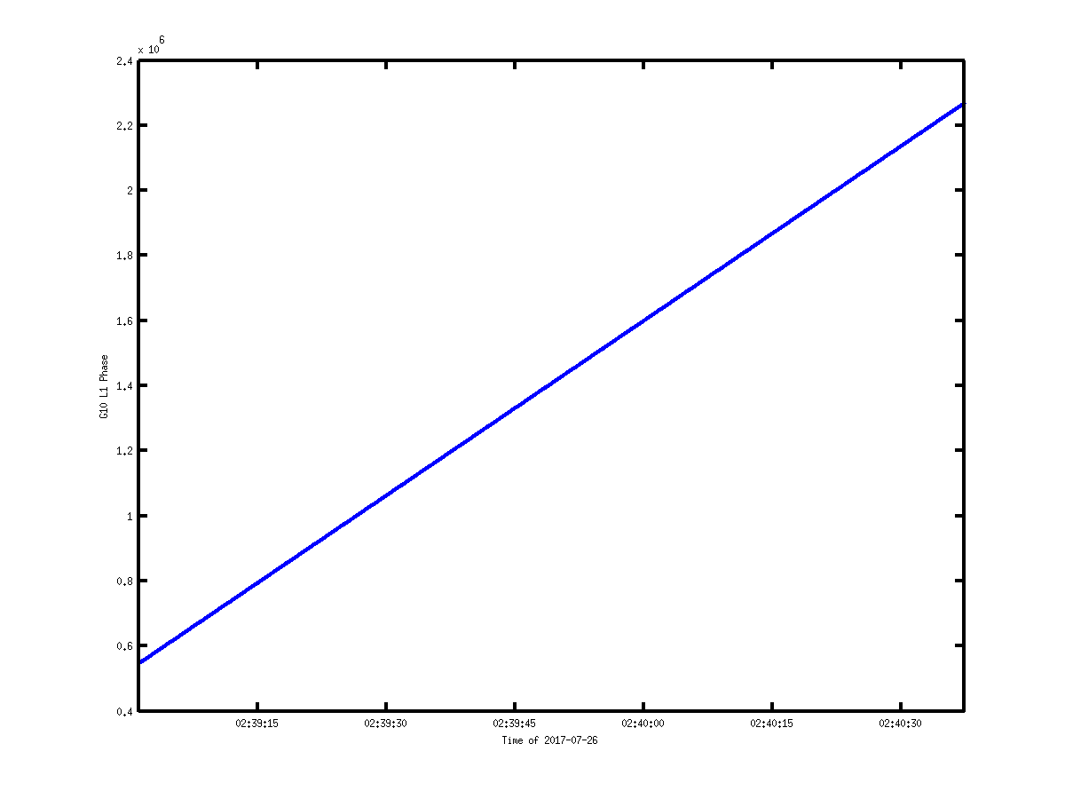
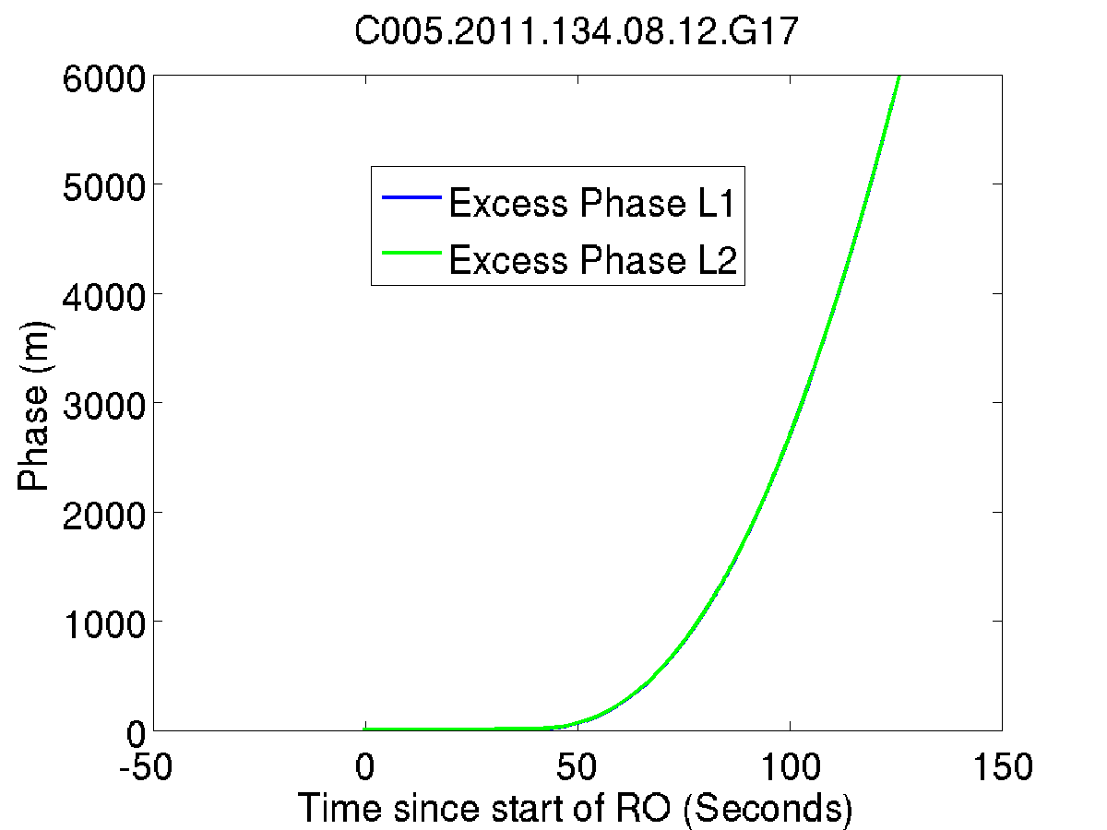
Calculation of Excess Phase
Leo Clock Error
Range of GNSS/LEO
Carrier Phase Measured
Relativity Effects
Schreiner et al., 2009
GNSS Clock Error
Excess Phase Wanted
Phase Ambiguity
Only time derivatives matter, constant offset has no effects!
Error orders (large fluctuation to small changing during one occ events ~2 minutes).
LEO CLK Error >GNSS CLK ERROR >Range ERROR >Relativity Effects>Phase windup >other errors. Cycle slips can be removed using model or GPS bits.
Observed Phase
L1/L2
Excess Phase

Slide 9
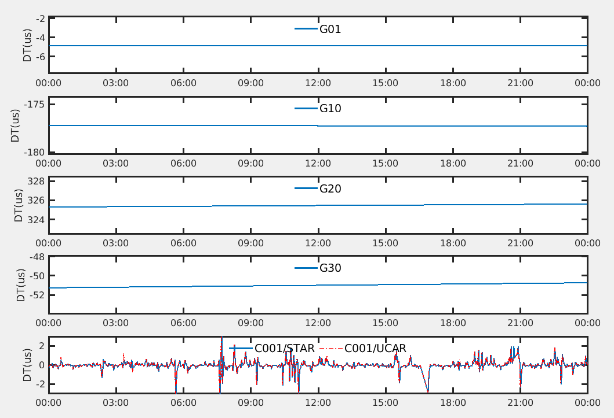
GNSS and LEO Clock Error
GPS Clock
Using CODE 30 seconds product
Some GPS satellite bias may be large (0.5 ms), but relatively stable (<1us/day)
Zero differencing requires high rate clocks.
C*ΔT.
LEO Clock
Bernese Final Solution
Bias <1us, but not as stable as GPS
Interpolation problem.
-C*ΔT (significant effects on excess phase)
High rate estimation need ground stations.
Single differencing is needed.

Slide 10
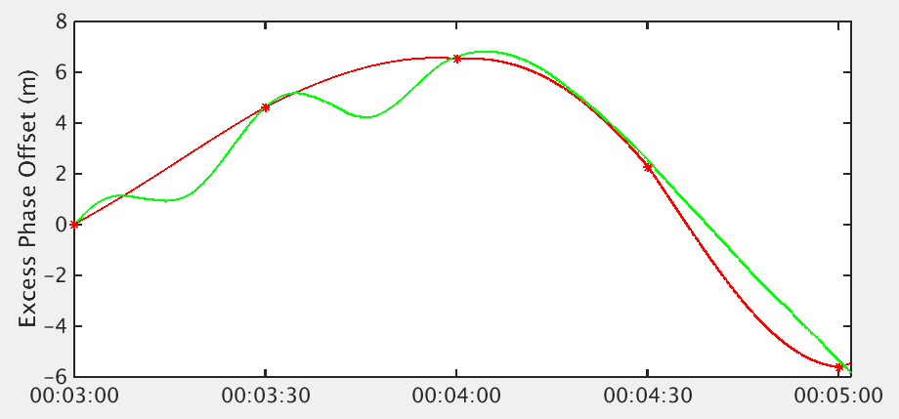
LEO Clock Error (Zero versus Single Differencing)
Single Differencing CLOCK estimation using reference link observations from POD Antenna.
30 Seconds LEO CLOCK interpolated to OCC time
Date: 2015-06-01
Clock data out of Bernese usually with more than 1 second intervals.
High rate observations on OCC requires interpolation for zero differencing.
High rate reference link in POD antenna is necessary if the clock is not stable: interpolation errors can be large.

Slide 11
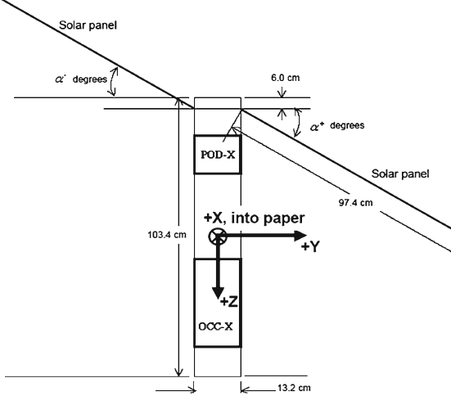
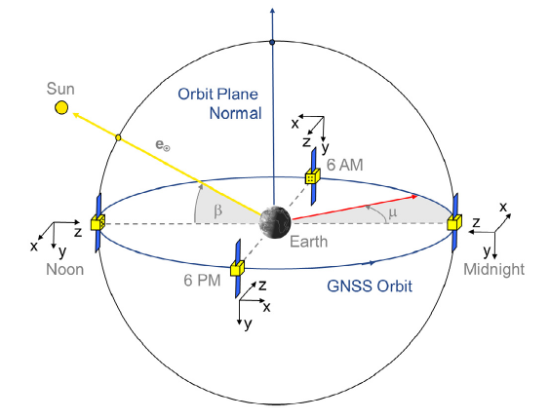
Antenna Offset and Phase Center Variations
$$ρ_{r}^{s}=\sqrt{{(x^{s}(t^{s})−x^{r}(t^{r}))}^{2}+{(y^{s}(t^{s})−y^{r}(t^{r}))}^{2}+{(z^{s}(t^{s})−z^{r}(t^{r}))}^{2}}$$
transmitter and receiver distance.
Different from mass center distance
Transmittance time Can be determined
Only affect distance in this term!
LEO Antenna Offsets and Antenna Phase center variation
Offset prelaunch determined. PCVs can update after launch.
Error can be present with Coordinate conversion (attitude).
Uncertainty can be more than few centimeter level from PCVs.
GNSS Antenna Offsets/Phase Center Variations
Broadcast by IGS, can be on the order of 2m.
GNSS attitude control
Orbit normal mode (ON) vs Yaw Steering mode
Attitude can be obtained from Sun, Earth and LEO vectors.
GNSS antenna pointing to earth, but not to satellite directly.
GPS/GLONASS/Galileo/Beidou difference
GNSS Antenna Phase Wind-up
Can be centimeter level due to
Antenna rotating from attitude control.
COSMIC Antenna
alignment
Hwang et al. 2009
Montenbruck et. al.,2015

Slide 12
Calculation of Excess Phase (Example)
exPh_L2
NOAA/UMD compared with UCAR
exPh_L1
Calculated Excess Phase agrees well (<2cm) with UCAR.
(Example: COSMIC-C001, G18, 2015-06-01 00:02
Using Single differencing with reference link: G21)

Slide 13
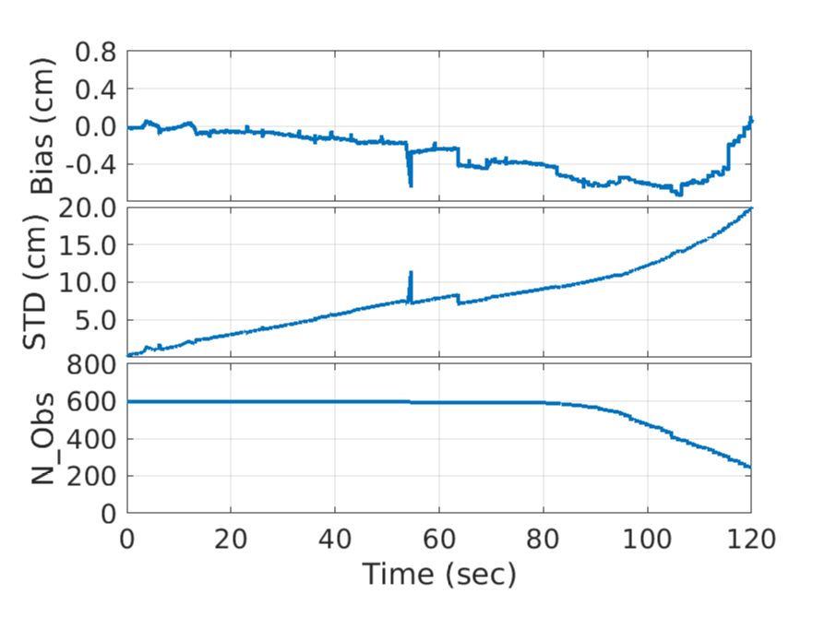
Excess Phase Difference Statistics
UCAR 637
UMD 613
598 in common
15 outlier profiles
Mean Excess Phase Bias in CM
Standard Deviation in CM
The mean bias is small less than 0.5cm, the standard deviation is less than 20cm. Errors can be from different sources: clock error (low resolution GNSS CLK), interpolation algorithm, position/vel errors, model errors, round off errors, coordinate conversions.
Profile numbers used
No cycle-slip detection has been applied!
Cycle slip detection are done in ROPP before Bending Angle calculation.

Slide 14
From Excess Phase to Bending Angle
What matters from observation
What matters in the inversion
Excess Doppler Shift
L1/L2 excess phase
Time derivative
Open loop/close loop
SNR
Quality
LEO/GNSS position/velocity
Antenna pos/vel
Geometric optical determination
Single path assumption
parameterization
Wave optical determination
Atmospheric Multiple path
Open loop
From [time, phase] space to [bending angle, Height] space
parameterization
Radio Occultation Processing Package (ROPP, Culverwell et al., 2015) has been used in testing.
Errors Propagation from Excess Phase/Pos/Vel to Bending Angle, time derivatives matter
Spherical symmetric assumption
L1/L2 ionosphere correction (first order approximation)
ECI coordinate transformation from ECEF (more artificial mistakes), Geolocation mismatch.
Wave optics inversion algorithm(s) CT2 versus Full Spectrum Inversion
Atmosphere multiple path effects
SNR cut off arbitrary

Slide 15
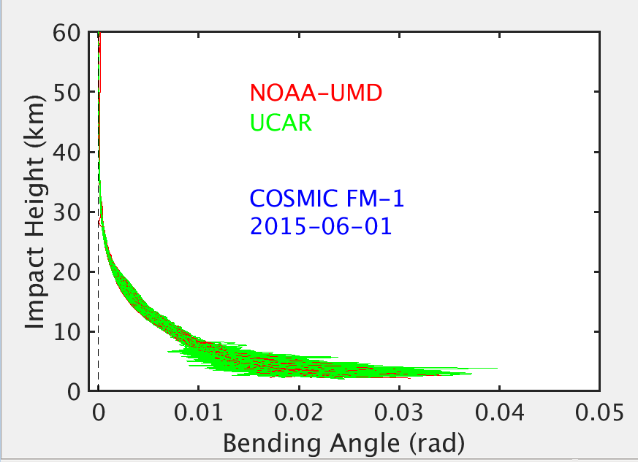
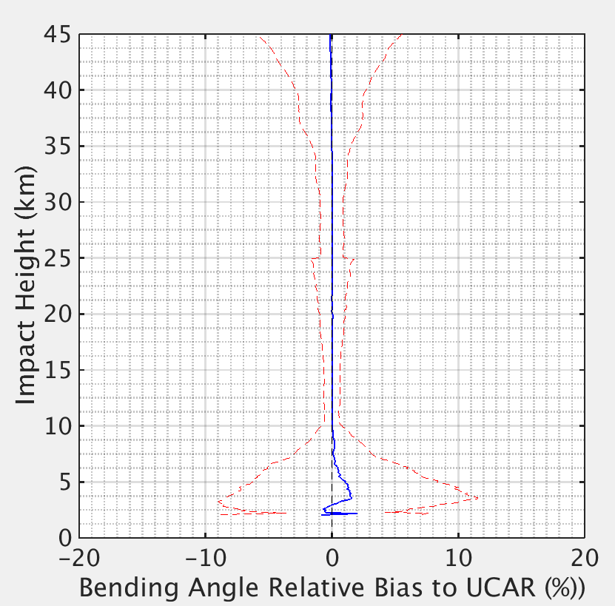
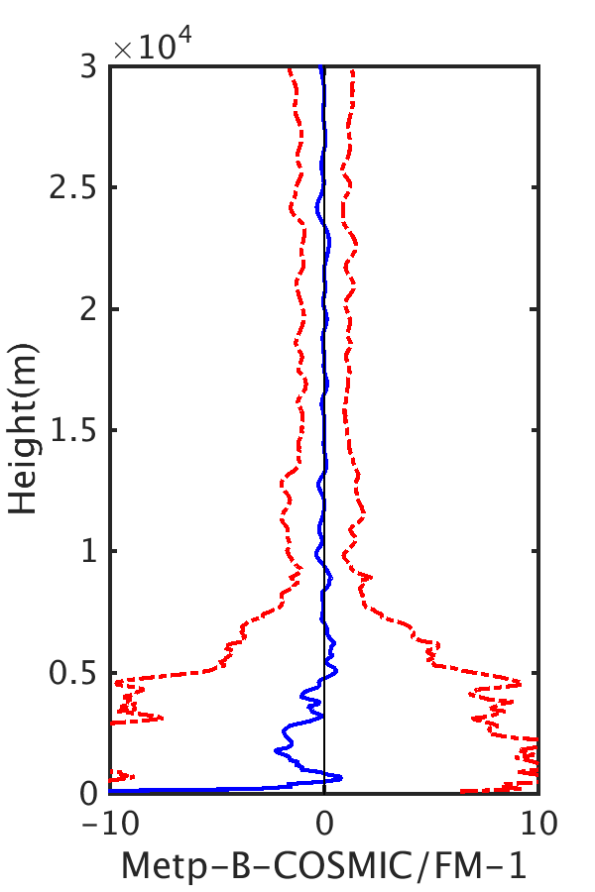
Bending Angle Comparison
Metop-B compared with COSMIC in GDAS
Bending Angle Profiles Comparison (UMD vs UCAR)
NOAA-UMD/ROPP compared with UCAR
Results are good but need improvements!

Slide 16
Summary
We have demonstrated the capability of processing Radio Occultation observations from low level to bending angle, which mainly serve for better Cal/Val activities and reprocessing at NOAA for COSMIS-2, CWDP and KOMPSAT-5 as well as future missions.
Though RO observations are ‘bias anchor’ for NWP model, products from different centers do have inter-mission, inter-center bias, especially on the lower troposphere. Only through understanding the processing procedure, we can understand the causes of the differences.
We have illustrated all possible error sources in calculation of excess phase down to centimeter levels, however, correct each term is not trivial:
Position/velocity inaccuracy, attitude errors
Antenna offset/phase center variations
Cycle slip detection (esp. in the open loop stage).
Clock error from both Leo and GNSS satellites
Interpolation schemes, coordinate conversion
Operational versus reprocessing
Different accuracy in the IGS GNSS Orbit products, Earth Orientation Products
Not enough observations for accurate representation of the satellite orbits.
Each error term is evaluated in the processing procedure.
Constant Errors not time related may not propagate into bending angle calculation, since only its time derivatives of excess phase are used in bending angle calculation.
For COSMIC-2, work is in progress. In addition, the addition of GLONASS can introduce more complexity and challenges.

Slide 17
Acknowledgement
We would like to thank the following organization and people for their help on training, discussion, analysis and data sharing:
EUMETSAT RO Team for RO on-site Training
Drs. Christian Marquardt, Axel Vonengeln, Yago Andres and Riccardo Notarpietro et al.
University of Bern, Astronomical Institute
For Bernese software training.
TAIWAN NSPO
UCAR/CDAAC
EUMET ROM SAF
Other NOAA STAR RO team members
Drs. Yuxiang He, Jun Dong, Wenhui Wang, Xinjia Zhou, and Erin Lynch etc.

Slide 18
What error is important?
$$Excess Doppler: f_{d}=\frac{d∆S}{dt}$$
Only terms related to time changing is important. Constant bias can be neglected.
$∆S$=$∅_{r}^{s}\left(t_{r}\right)−ρ_{r}^{s}+c∙{δt}^{r}−c∙{δt}^{s}+N+D+w+ε$
$$ρ_{r}^{s}=\sqrt{{(x^{s}(t^{s})−x^{r}(t^{r}))}^{2}+{(y^{s}(t^{s})−y^{r}(t^{r}))}^{2}+{(z^{s}(t^{s})−z^{r}(t^{r}))}^{2}}$$
Depending on POD results for orbit and clock errors. Recursively depends on the carrier phase model in POD software, but different solutions can be set in different algorithm in POD procedure.
${t^{r} is receiver clock at the measurement. t}^{s}$ is unknown, need to calculate

Slide 19
Error Sources in the excess Phase Model
Accuracy of Position and Velocity of the satellite (transmitting and receiving antenna).
Cosmic generally about 10cm level (post processing).
Metop-A/B 5 cm level
IGS GNSS Orbit Products
Final(2.5cm, ~two weeks delay), Rapid(3.5 cm, ~1-2 days), Ultra-rapid (5cm,3-9hours), broadcast (1m)
From Mass Center to Antenna Phase center
Satellite Attitude and Antenna Offset parameters, Phase center variations
GNSS/Leo satellite clock errors.
A few to hundred nano seconds, but very stable. (thinking of light speed).
Can affect the accurate determination of position/velocity
Cycle slips in the time series, especially near surface
GPS signals are waves, the phase can be determined using replica oscillator on-board GPS receiver.
Using navigation bit series, time series demodulation and open-loop phase model
Coordinate transformation Errors
Attitude error, ECEF/ECI transformation inconsistency
Excess Phase Model
L1/L2 time series noise level
Numerical Scheme/Round off errors
L1/L2 ionosphere delay correction

Slide 20
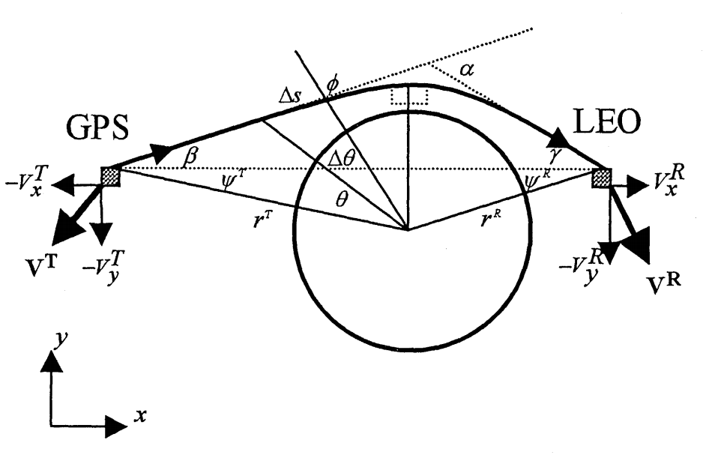
How GNSS RO Works
Bending Angle
f
$$f_{d}$$
RO: By measuring the wave phase change, the bending angle is derived as function of impact parameter.
Impact Parameter a
Doppler effect: The additional received signal frequency $f_{d}$ will be different from GPS signal $f$ due to relative movement.
The bending angle $\text{α}\text{=}β+γ$ can be obtained using Geometric Optical Method, following this two equations:
with assumption: atmospheric spherically symmetric, single path propagation;
good above UT.
For multiple path rays, Waver Optics methods are applied.
$$f_{d}=\frac{1}{2π}\frac{ds}{dt}$$
Requires accurate Position and Velocity determination
$r^{T}\sin{(β+Ψ^{T})}=\sin{(γ+Ψ^{R})}$=a
S: Measured Wave phase
Healy, 2001

Slide 21
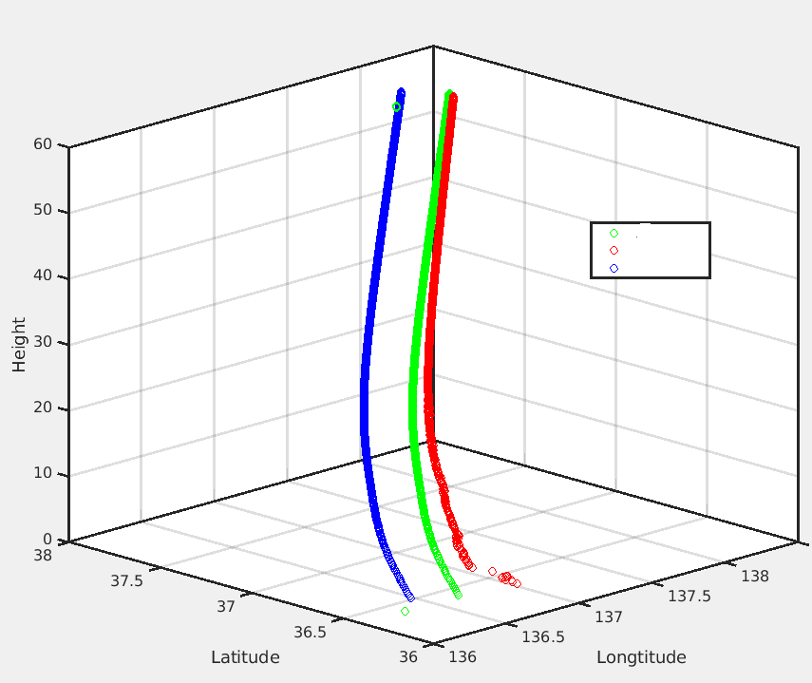
ECI/ECF Coordinate Transformation
Relativity effects correction to excess phase needs inertial coordinate system, e.g Earth Centered Inertial (ECI) coordinate system. Attitude Quaternions are usually expressed as from spacecraft to ECI coordinate.
Different ECI can cause confusion and misusage.
E.G. J2000 vs True of Date
Stick with one from start to end should be ok, but mixed usage can cause errors in Bending Angle inversion and profile geolocation.
Consistency of ECI in attitude files and in Bernese (J2000)
Quaternions is defined as transformation from spacecraft to ECI.
J2000/TOD attitude file misused can cause additional error in POD (<cm level).
ECI to ECEF transformation in bending angle determination
Antenna locations are in ECI
Occultation perigee needs to be represented as geodetic lon/lat in ECEF.
Using excess phase and associated satellite positions in a TOD ECI coordinates as J2000 can cause more than 15 km profile geolocation difference.

Slide 22
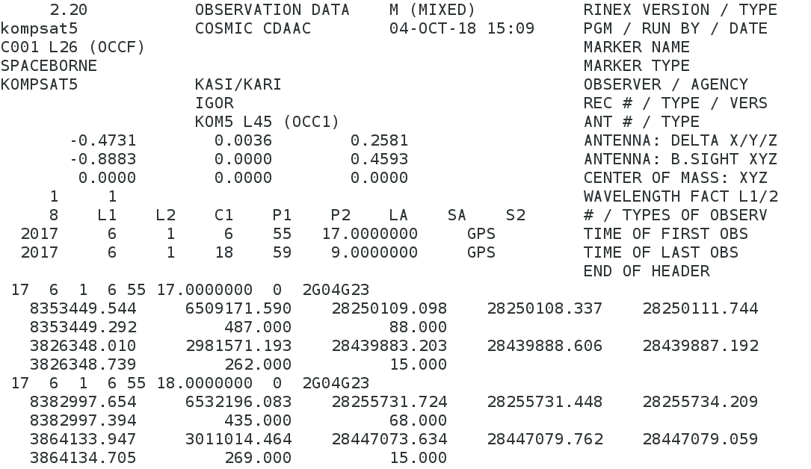
RO observations
GPS signal for POD
GPS signal for Occultation
GPS/GNSS on Zenith
Low rate (1Hz)
Pseudorange
C/A code, P1/P2
Time delay*speed of light
Carrier phase
Phase*wavelenghth (meters)
Doppler shift
S1/S2 (SNR or Signal Amplitude)
GPS/GNSS on limb
High Rate (50/100 Hz)
time/Prn/track-status
Carrier Phase (L1/L2), Pseudo Range , open-loop model phase

Slide 23
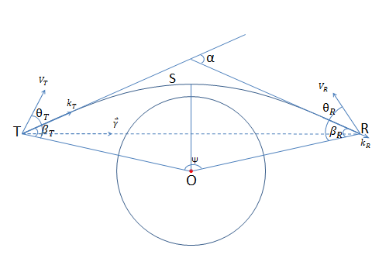
Explanation of Carrier Phase
${A(t_{T})e}^{i∅(x(t_{T}),t_{T})}$
${A(t_{R})e}^{i∅(x(t_{R}),t_{R})}$
Excess Phase
Excess Doppler shift: f_{d}=$\frac{d∆s}{dt}$
Full Phase
$$∆s=\int{ndr}−\overline{TR}$$
$∅(x(t_{R}),t_{R})\text{−}∅\left(x\left(t_{T}\right),t_{T}\right)=$S= $∆s$+ $\overline{TR}$
$∅\left(x\left(t_{R}\right),t_{R}\right)=φ+c{δt}_{R}{+N}_{R}$(t₀)
Only time derivative matters.
Phase measurements needs locked.
$∅\left(x\left(t_{T}\right),t_{T}\right)=2πf(t_{T}−t_{1})+N_{T}$(t₁)+$c{δt}_{T}$
$∆s$=$φ\text{−}2πf(t_{T}−t_{1})$+N_{R}(t₀$)−N_{T}$(t₁)+$c{δt}_{R}$- $c{δt}_{T} −\overline{TR}+ε$
Observed Carrier Phase
Clock Corrections

Slide 24
Relativity Effects
In Earth Centered Inertial Coordinate system
Range Correction
Contribute to excess phase (order~ 0.2m)
Contribute to transmittance time determination.
0.2m/C~<1ns
GPS Clock Correction (proper time and coordinate time)
Generally proportional to GPS clock error.
LEO Clock Correction (proper time and coordinate time)
Single differencing, removed both
Zero differencing, can be modeled, but very small.

Slide 25
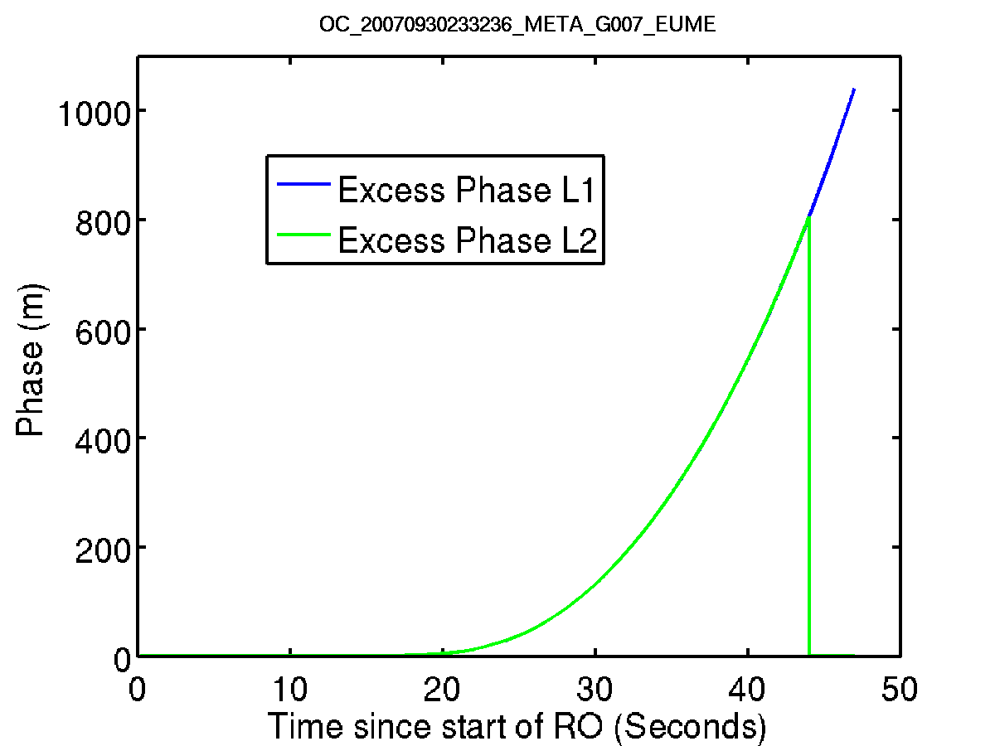
Excess Phase Example
Carrier Phase (10⁶m)
2.4
2.0
1.6
1.2
0.8
0.4
Raw Measurements: Carrier Phase
Processed Excess Phase: path delay passing atmosphere as function of time
0 15 30 45 60 75 90
Time(seconds)
Metop (NetCDF)
COSMIC

