Slide 1
Intercomparison of Hyperspectral Infrared Sounders with Simulated Radiances from GNSS-RO Inputs
Erin Lynch¹, Flavio Iturbide-Sanchez², Ben Ho², Changyong Cao², Xi Shao¹
1: University of Maryland/ESSIC/CISESS
2: NOAA/NESDIS/STAR

Slide 2
Outline
Motivation
Approach
Intercomparison methods used in this study
Suomi-NPP CrIS Side-2 Intercomparison
MetOp-C IASI Intercomparison
Summary and Conclusions

Slide 3
Motivation
GNSS Radio Occultation (RO) measurements provide a stable reference for use in numerical weather prediction (NWP) and anchor dataset to perform bias correction for other types of atmospheric sounding data
Hyperspectral radiometric sounders, like CrIS (Cross-track Infrared Sounder) also serve as on-orbit calibration reference standards for other broad- or narrow-band infrared (IR) observations as well as contributing to NWP
Both are accurate, stable, and based on SI traceable standards (Atomic Frequency Standard vs. Radiance respectively)
In this study, GNSS RO data from COSMIC, KOMPSAT-5, and the MetOp-A and B GRAS instruments provide high resolution profiles of atmospheric variables that are used as a reference to validate the brightness temperatures observed by IR sounders.
In addition, intercomparisons between IR sounds are also used to validate.

Slide 4
Approach
1
RO profiles
Assess the radiometric consistency of two hyperspectral IR sounders:
The Cross-track Infrared Sounder (CrIS) onboard Suomi-NPP before and after the switch to the redundant electronics
The Infrared Atmospheric Sounding Interferometer (IASI) onboard the recently launched MetOp-C compared to the IASI instrument on MetOp-B
Two methods:
Comparison between observed brightness temperatures and simulated brightness temperatures from a radiative transfer model with RO data providing the temperature and water vapor inputs
Comparison to other well calibrated hyperspectral IR sounders during Simultaneous Nadir Overpasses (SNO)
CRTM Simulated
Brightness Temperatures
O-B Bias
Double Difference
O-B Bias
IR Sounder #1
IR Sounder #2
Transfer IR Sounder

Slide 5
Approach
RO profiles
Assess the radiometric consistency of two hyperspectral IR sounders:
The Cross-track Infrared Sounder (CrIS) onboard Suomi-NPP before and after the switch to the redundant electronics
The Infrared Atmospheric Sounding Interferometer (IASI) onboard the recently launched MetOp-C compared to the IASI instrument on MetOp-B
Two methods:
Comparison between observed brightness temperatures and simulated brightness temperatures from a radiative transfer model with RO data providing the temperature and water vapor inputs
Comparison to other well calibrated hyperspectral IR sounders during Simultaneous Nadir Overpasses (SNO)
CRTM Simulated
Brightness Temperatures
Double Difference
IR Sounder #1
IR Sounder #2
SNO Bias
SNO Bias
Transfer IR Sounder
2

Slide 6
CRTM Based Intercomparison
Match IR FOVs with
RO Profiles
Condition | Criteria
Distance | ≤ 200 km
Time difference | ≤ 3 hours
Surface | Over ocean
Radio Occultation wetPrf data from CDAAC
COSMIC
KOMPSAT-5
MetOp-A and –B GRAS
Each RO profile is collocated with a single clear sky FOV over ocean. Cloud cover assessed using ECMWF reanalysis cloud cover and threshold cutoff for biases in surface channels.
Community Radiative Transfer Model (CRTM) v2.3.0 developed by JCSDA used.
CRTM v2.3.0
Inputs from RO retrievals
Temperature
Water Vapor Pressure
Pressure
Inputs from ECMWF Reanalysis
Surface wind speed and direction
Ozone profile
Skin Temperature
Inputs from IR data
FOV latitude and longitude
Satellite azimuth and zenith angles
Solar azimuth and zenith angles
Simulated brightness temperatures
Brightness temperature mean bias
Compute the bias in BT for each FOV pair
Average over FOV pairs from all SNOs

Slide 7
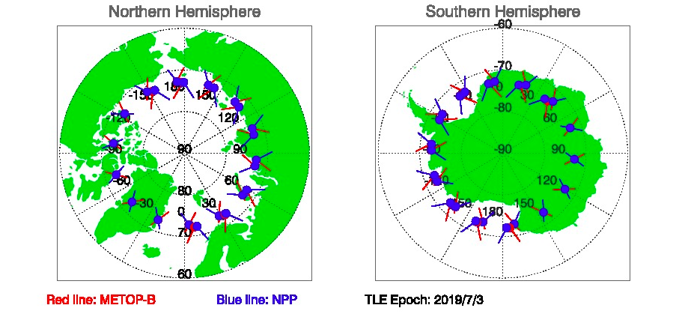
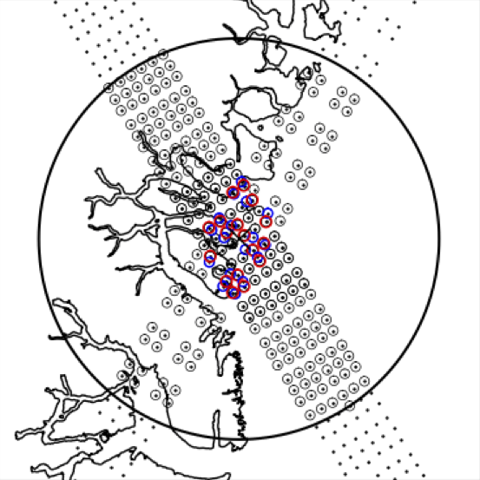
SNO Based Intercomparison
Match CrIS FOVs with
IASI FOVs
Condition | Criteria
FOV distance | ≤ 13 km
Time difference | ≤ 3 min
View angle difference | abs(cos(zen_cris)-cos(zen_iasi)) ≤ 0.01
Homogeneity | Mean(Stdev(CrIS FOVs in FOR)/Mean(CrIS FOVs in FOR)) < 50%
SNO opportunities with <2 min separation nadir overpasses occur every ~50 days between Metop-B and S-NPP and last for ~2 days with ~48 SNOs during that period
Overlapping pairs of CrIS and IASI FOVs are found. Only homogeneous scenes are considered to minimize collocation errors.
IASI has higher spectral resolution and no gaps between bands. IASI spectra can be deconvolved to match the CrIS spectral grid and make a direct comparison.
Remove Gaussian apodization
Inverse Fourier Transform to interferogram
IASI-to-CrIS
Deconvolution
Truncate to CrIS OPD
Fourier Transform to CrIS spectrum
Apply Hamming apodization
BT
mean bias
Compute the bias in BT for each FOV pair
Average over FOV pairs from all SNOs

Slide 8
Challenges
Viewing geometry: Limb vs. nadir
Time difference
Colocation uncertainties
Sample limitations in RO
Errors in the RO temperature and vapor pressure retrievals
Errors introduced by the radiative transfer model
RO uncertainties in the upper atmosphere due to small bending angle
Low troposphere uncertainties due to water vapor SNR, and turbulence
Infrared sounding limited to clear sky conditions (clouds)
SNOs occur relatively infrequently – every ~50 days

Slide 9
Suomi-NPP CrIS Side-1 vs Side-2
Assess the radiometric consistency of S-NPP CrIS Side-2 compared to Side-1
using transfer targets:
Simulated CRTM brightness temperatures with RO inputs
SNOs with MetOp-B IASI

Slide 10
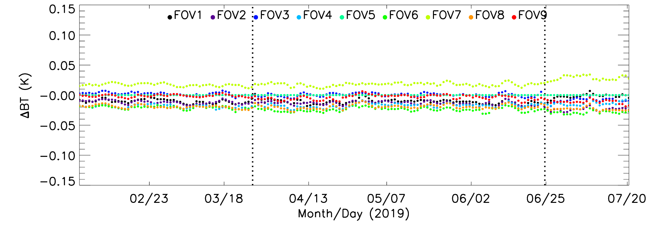
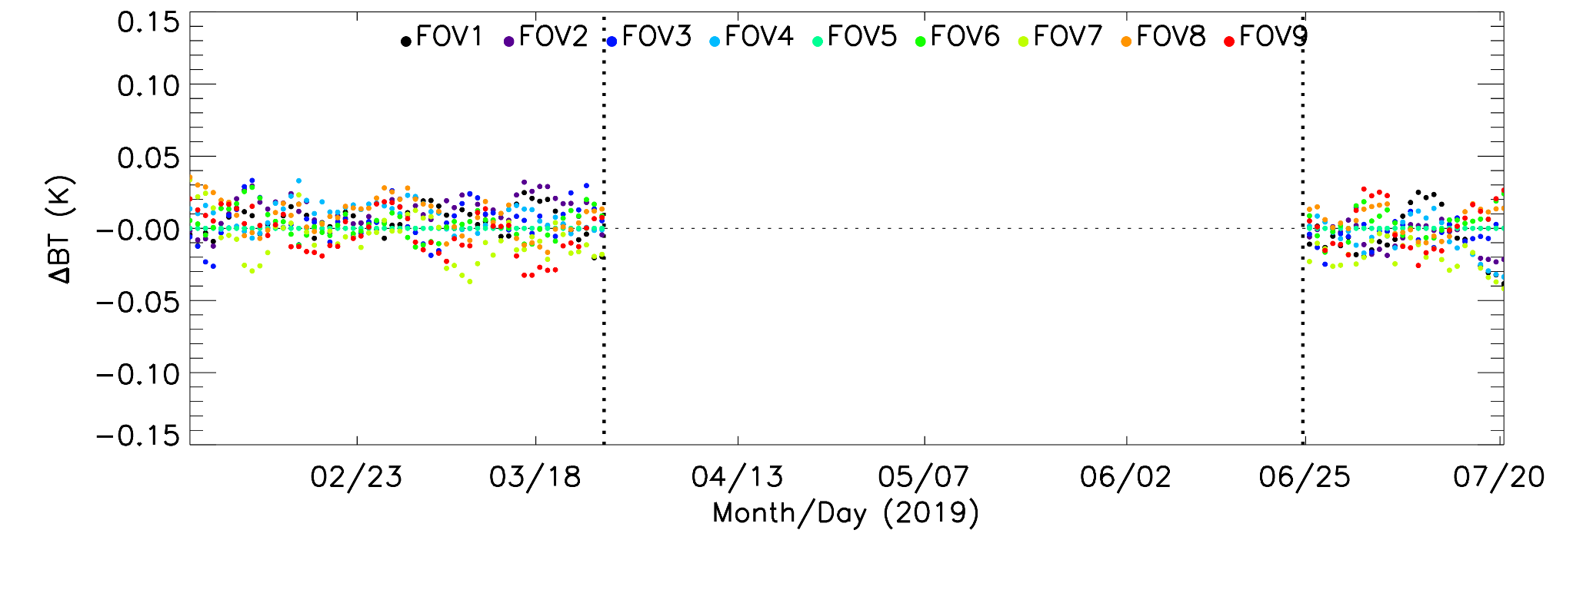
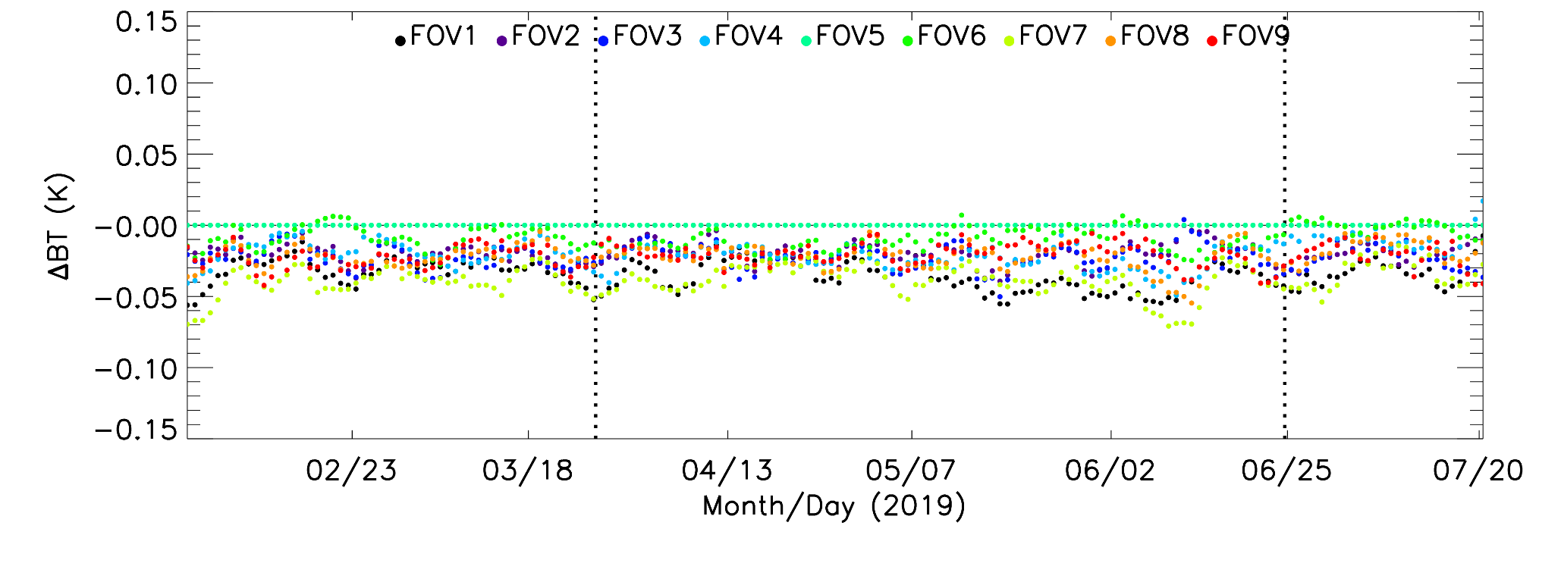
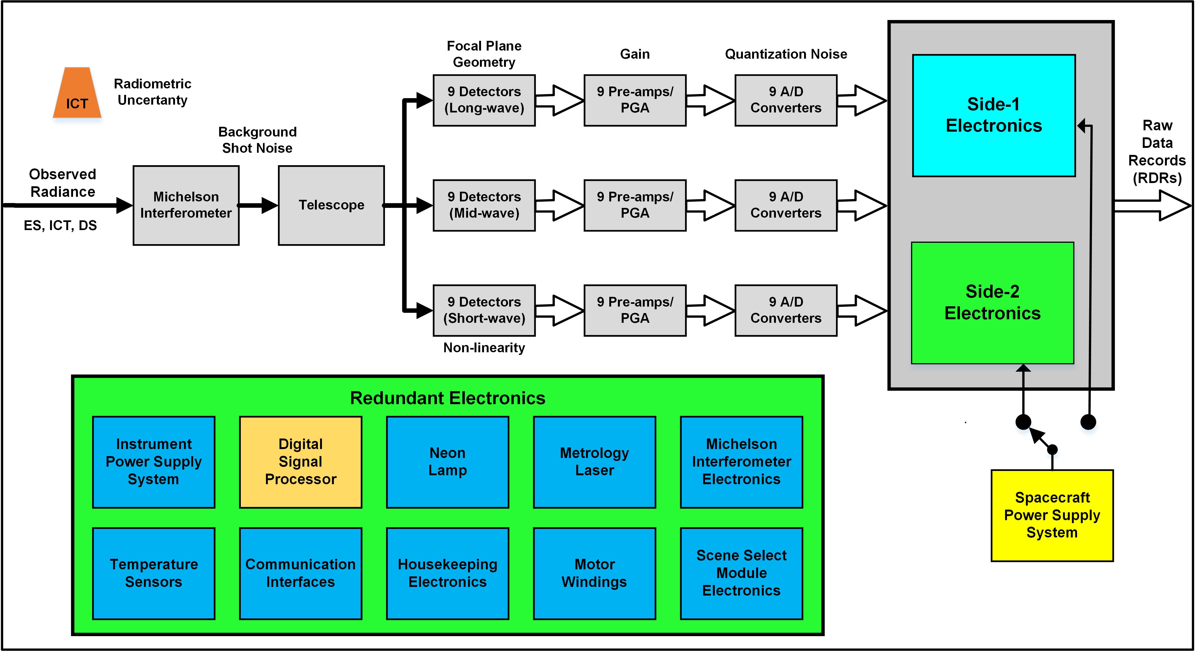
Suomi-NPP CrIS Midwave Band Recovery
FOV-to-FOV Radiometric Consistency
On March 23, 2019, an anomaly resulted in the loss of the Midwave Ifrared (MWIR) band in the S-NPP CrIS raw data record (RDR) interferograms.
The root cause was likely a failure in the MW signal processor field programmable gate array and surrounding circuitry.
To recover the missing band, a switch to the redundant side electronics was made on June 24, 2019.
The redundant electronics replace several existing instrument components with a different version, including temperature sensors required for radiometric calibration.
The redundant electronic were characterized pre-launch and little change to the spectral and radiometric performance of the instrument was expected.
Following an update to the calibration parameters improving the geoloction accuracy, S-NPP CrIS SDR product reached provisional maturity on August 1, 2019.
To compare the Side-1 sensor data record (SDR) product to Side-2, data from August 2018 and August 2019 will be used.
Longwave
Midwave
Shortwave
MWIR Band
missing

Slide 11
S-NPP CrIS Side-1 vs Side-2 Intercomparison CRTM BT with RO Input as Transfer Target
Mean Bias: (BT_{obs} – BT_{CRTM})
MetOp-B GRAS wetPrf
CRTM Simulated
Brightness Temperatures
O-B Bias
Double
Difference
O-B Bias
Standard Deviation
S-NPP CrIS Side-2
S-NPP CrIS Side-1
S-NPP Side 1: August 2018
S-NPP Side 2: August 2019
Small negative bias in the LW window channels consistent and ~1 K positive bias in the water vapor channels of the midwave are both consistent with CRTM simulated BT.
The larger bias in the midwave suggests there may be errors in the moisture variables input to the CRTM.
Double difference shows nearly all LW channels within 0.1 K and nearly all MW channels within 0.25 K.
Double Difference: (BT_{obs} – BT_{CRTM})_{Side-2} – (BT_{obs} – BT_{CRTM}) _{Side-1}

Slide 12
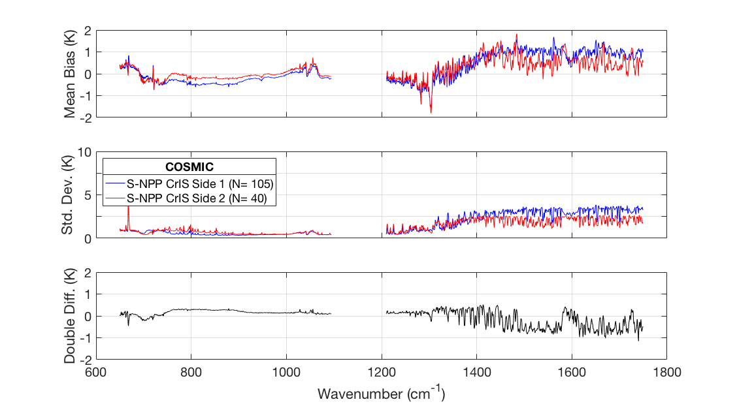
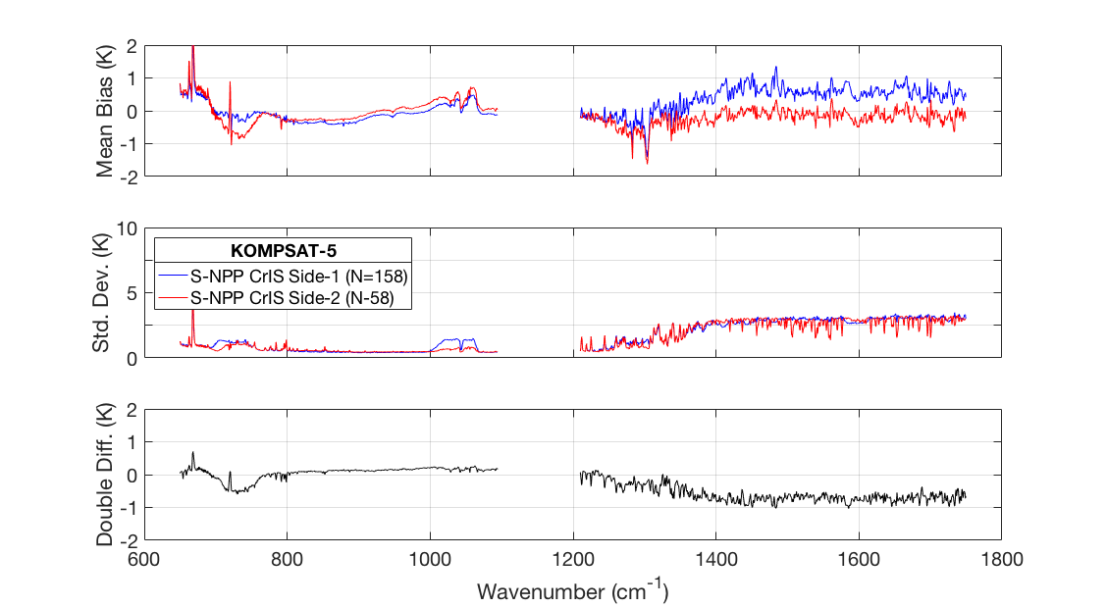
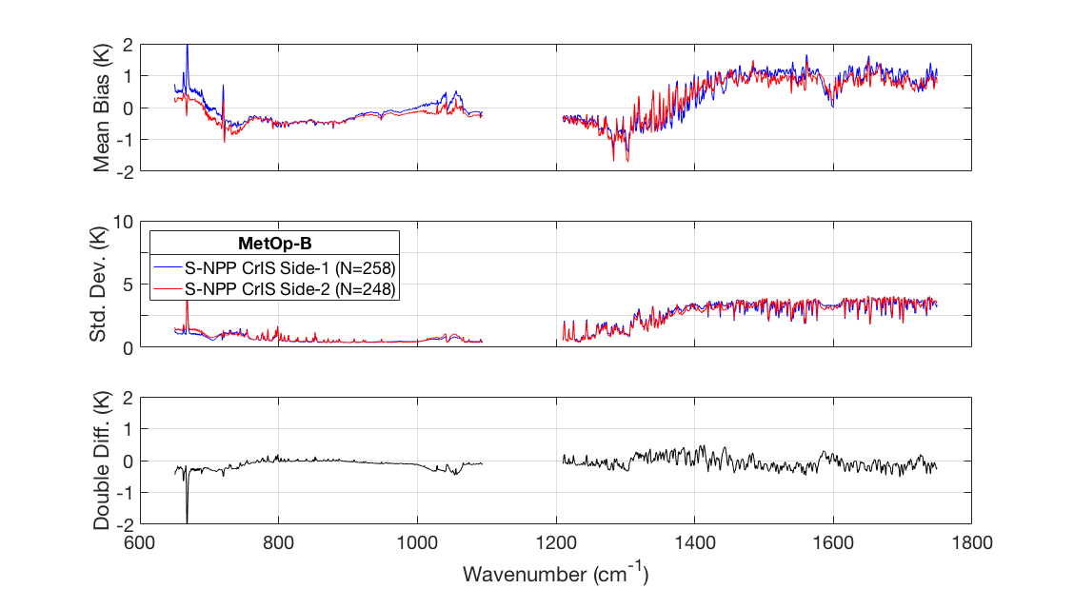
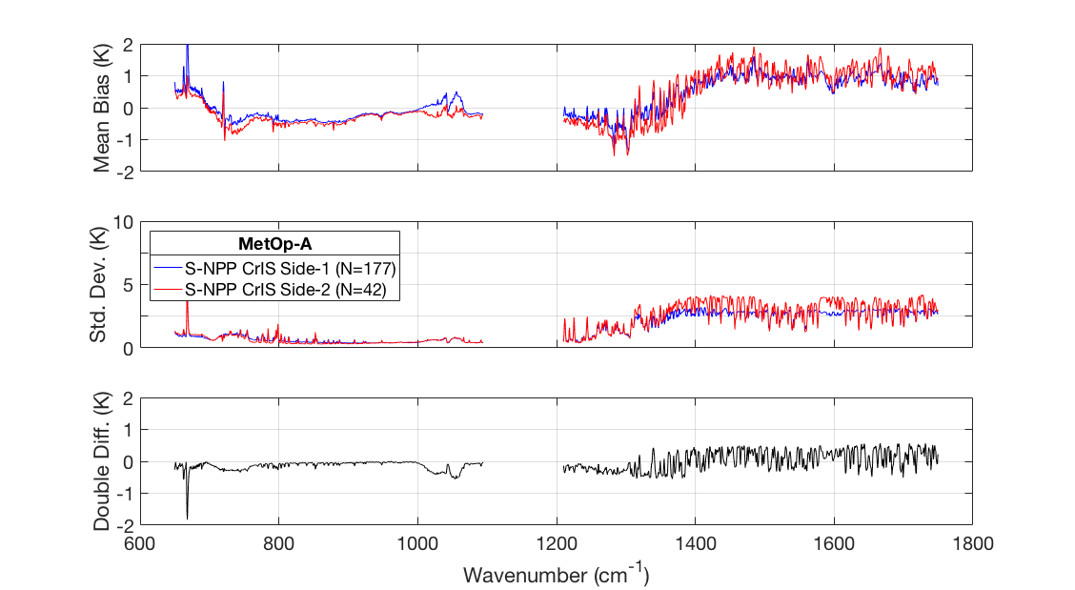
S-NPP CrIS Side-1 vs Side-2 Intercomparison Comparison of RO Inputs
All missions show large positive biases in the MW.
For aging missions, counts between years are inconsistent.
Low counts in 2019 compared to 2018 could cause differences in MW biases.
MetOp GRAS both show consistency between years, despite low counts for MetOp-A GRAS in 2019.
COSMIC
Mean Bias
Standard Deviation
Double Difference
KOMSAT-5
Mean Bias
Standard Deviation
Double Difference
MetOp-A GRAS
MetOp-B GRAS
Mean Bias
Standard Deviation
Double Difference
Mean Bias
Standard Deviation
Double Difference

Slide 13
S-NPP CrIS Side-1 vs Side-2 Intercomparison IASI-B SNOs as Transfer Target
Mean Bias: (BT_{CrIS} – BT_{IASI-B})
Double
Difference
S-NPP CrIS Side-2
S-NPP CrIS Side-1
Bias
Bias
Standard Deviation
MetOp-B IASI
S-NPP Side 1: August-December 2018
S-NPP Side 2: August-December 2019
Excellent agreement between the Side-1 and Side-2 longwave and shortwave bands.
Double differences are within 0.05 K for the shortwave and 0.1 K for the midwave for most channels.
Double Difference: (BT_{CrIS} – BT_{IASI-B})_{Side-2} – (BT_{CrIS} – BT_{IASI-B}) _{Side-1}

Slide 14
MetOp-C IASI
Assess the radiometric consistency of MetOp-C IASI compared to MetOp-B IASI
using transfer targets:
Simulated CRTM brightness temperatures with RO inputs
SNOs with S-NPP CrIS

Slide 15
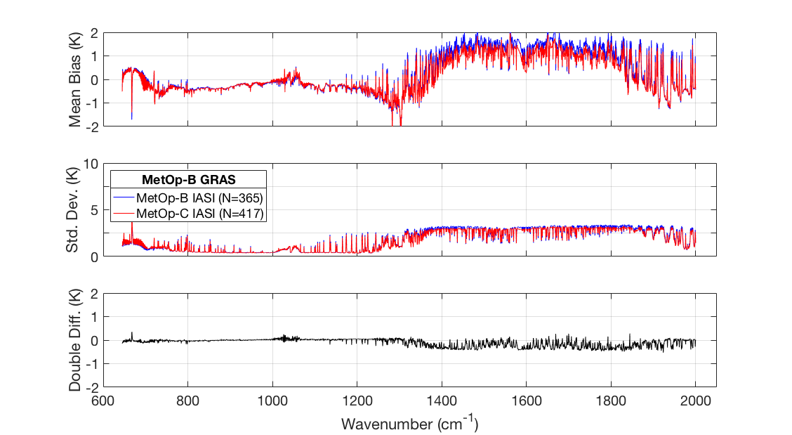
MetOp-C IASI vs MetOp-B IASI Intercomparison CRTM BT with RO Input as Transfer Target
Mean Bias: (BT_{obs} – BT_{CRTM})
MetOp-B GRAS wetPrf
CRTM Simulated
Brightness Temperatures
O-B Bias
Double
Difference
O-B Bias
Standard Deviation
MetOp-C IASI
MetOp-B IASI
MetOp-C launched on November 7, 2018 carrying the third IASI instrument
IASI-C reached operational status in July 2019.
Comparisons made to IASI-B via RO input to CRTM with IASI-C coefficients
Most LW channels are within 0.1 K and most MW channels are within 0.5 K. There is a slight negative bias between IASI-C and IASI-B in the midwave.
Double Difference: (BT_{Obs} – BT_{CRTM})_{IASI-C} – (BT_{obs} – BT_{CRTM}) _{IASI-B}

Slide 16
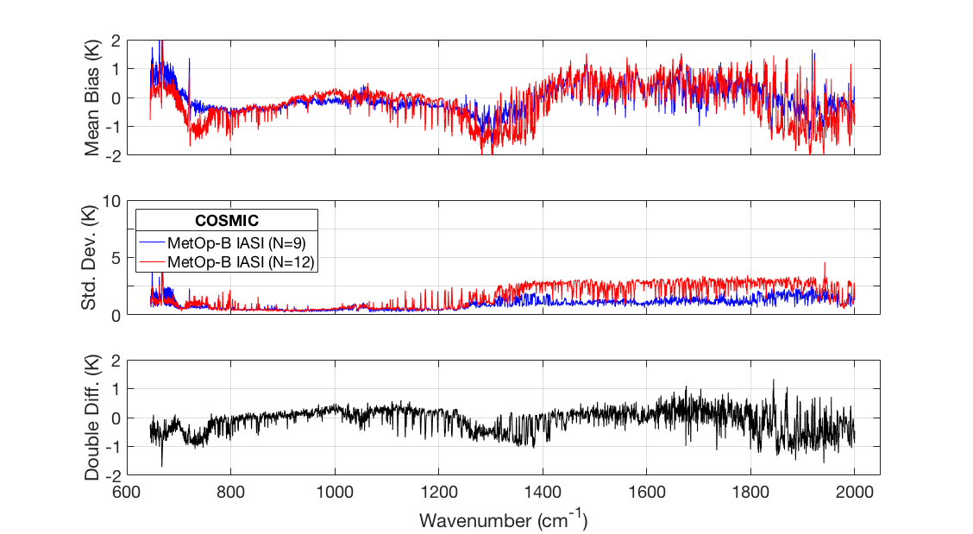
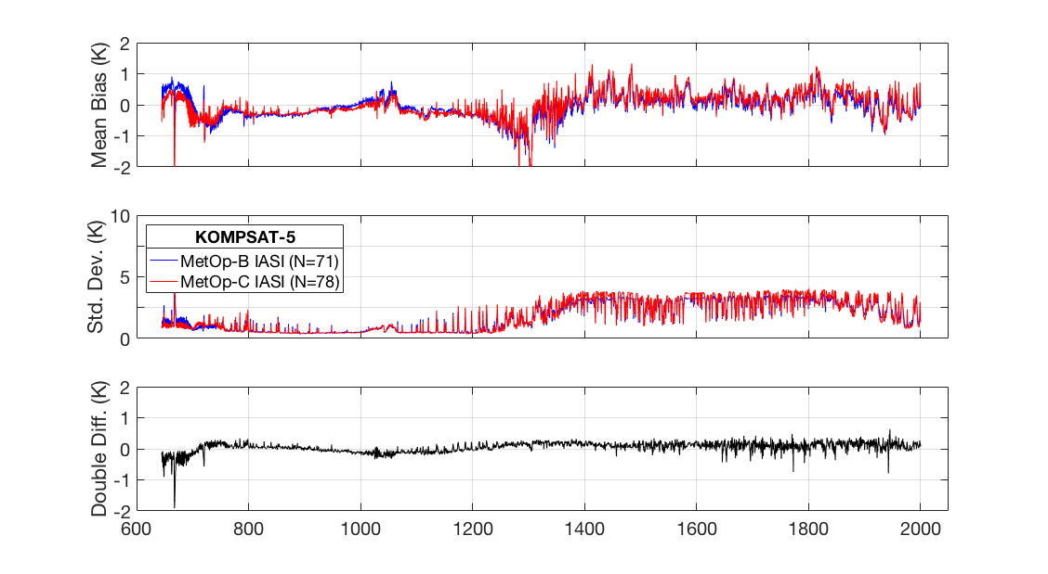
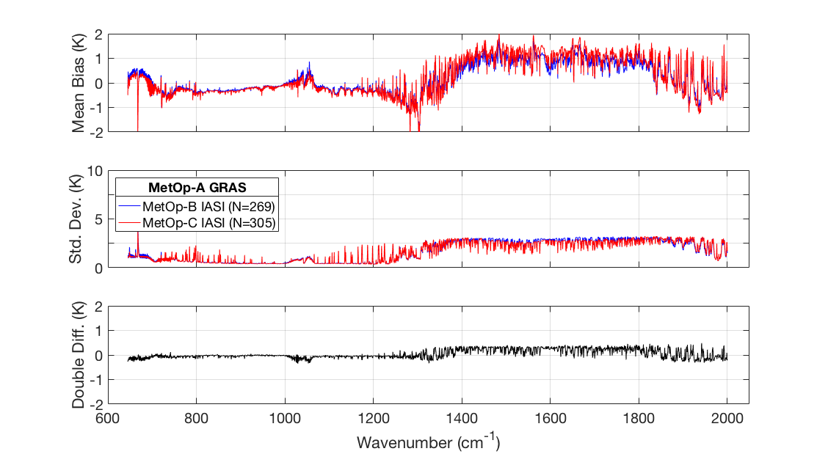
MetOp-C IASI vs MetOp-B IASI Intercomparison Comparison of RO Inputs
Since data for each comparison comes from the same month, results from different missions are more consistent.
COSMIC suffers from diminished counts in 2019 so there were very few matchups.
The double differences using MetOp-A GRAS simulated BTs and MetOp-B GRAS simulate BTs show different signs.
COSMIC
KOMSAT-5
Mean Bias
Standard Deviation
Double Difference
Mean Bias
Standard Deviation
Double Difference
MetOp-A GRAS
MetOp-B GRAS
Mean Bias
Standard Deviation
Double Difference
Mean Bias
Standard Deviation
Double Difference

Slide 17
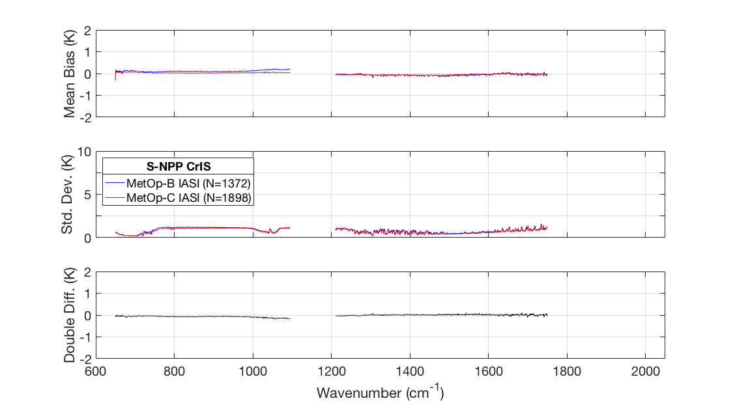
MetOp-C IASI vs MetOp-B IASI Intercomparison S-NPP CrIS SNOs as Transfer Target
Mean Bias: (BT_{obs} – BT_{CRTM})
Double
Difference
MetOp-C IASI
MetOp-B IASI
Bias
Bias
Standard Deviation
S-NPP CrIS
SNOs with S-NPP CrIS serve as a transfer target for IASI-C and IASI-B intercomparison.
The comparison made on CrIS spectral grid (lower resolution and gaps compared to IASI spectrum)
High degree of consistency between IASI-C and IASI-B in both the short wave and midwave double differences.
Double Difference: (BT_{Obs} – BT_{CrIS})_{IASI-C} – (BT_{obs} – BT_{CrIS}) _{IASI-B}

Slide 18
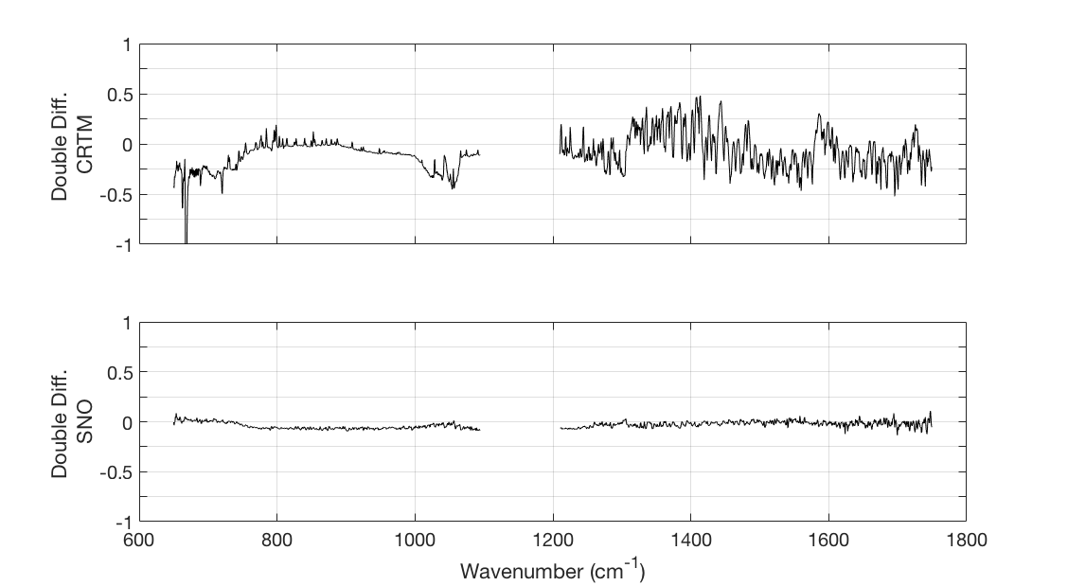
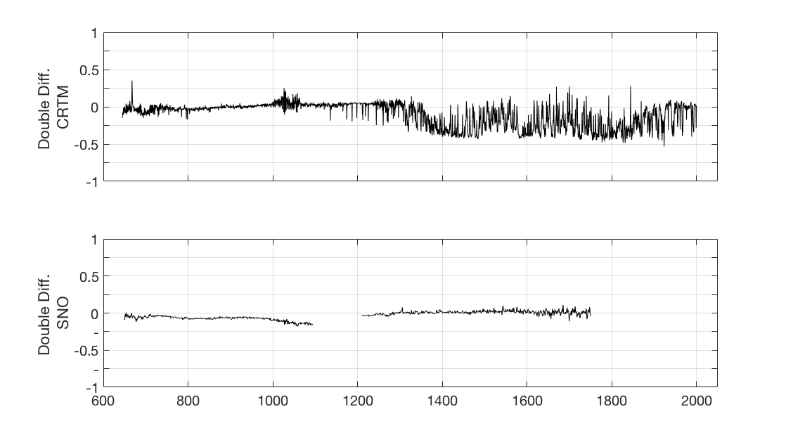
Summary of Results
MetOp-C IASI
Shows excellent agreement with MetOp-B IASI
Intercomparison with CRTM simulated BT with MetOp-B GRAS profiles as input:
0.1 K in LW
0.5 K in MW
Intercomparison with MetOp-B IASI SNOs:
Within 0.05 K in the LW and MW
Suomi NPP CrIS Side-2
Shows excellent agreement with S-NPP CrIS Side-1
Intercomparison with CRTM simulated BT with MetOp-B GRAS profiles as input:
0.1 K in LW
0.25 K in MW
Intercomparison with MetOp-B IASI SNOs:
Within 0.05 K in the LW and MW.
Double differences: Side-2 – Side-1
Double differences: IASI-C – IASI-B
CRTM with MetOp-B GRAS input as transfer
CRTM with MetOp-B GRAS input as transfer
SNOs with MetOp-B IASI as transfer
SNOs with S-NPP CrIS as transfer

Slide 19
Conclusions
Intercomparisons between IR sounders using simultaneous nadir overpasses (SNOs) is a well established method. The method demonstrates excellent consistency between S-NPP CrIS Side-2 and Side-1 and between the IASI instruments on MetOp-C and MetOp-B.
Intercomparisons between observed brightness temperatures and simulated brightness temperatures using a radiative transfer model such as the CRTM are also well established. This method introduces some uncertainty from the radiative transfer model itself.
GNSS-RO measurements provide high resolution retrieved temperature and moisture profiles. These data can serve as inputs to a radiative transfer model for intercomparisons; however additional uncertainties are introduced due to the matchup criteria and potential errors in the retrievals.

