Slide 1

NOAA Integrated Cal/Val System (ICVS) for Radio Occultation Performance Monitoring and Data Quality Assurance
Xinjia Zhou^{1,2}, Shu-peng Ben Ho¹, Changyong Cao¹
NOAA STAR;
GST, Inc.

Slide 2
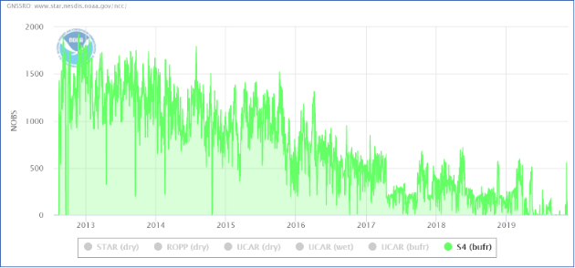
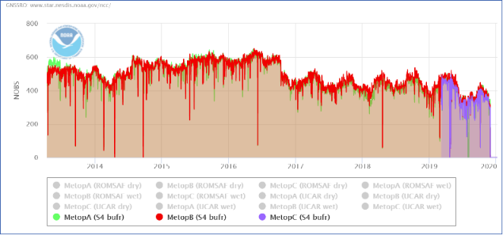
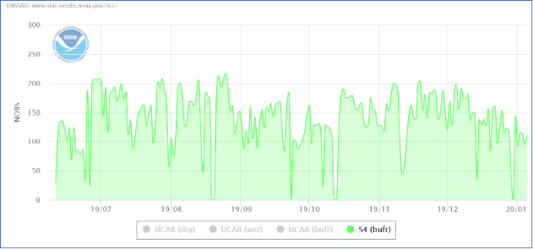
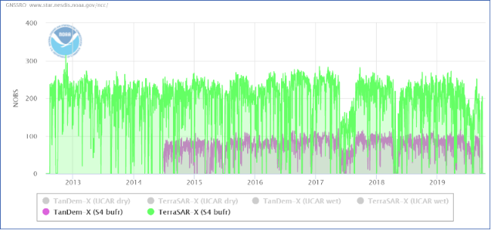
Operational GNSS-RO for NOAA NWP
COSMIC
Currently ~2000 daily RO profiles are available for NWP operations
  Declining number of profiles from COSMIC1
  Metop A/B/C, ~1200 daily
  KOMPSAT-5, ~150 daily
  TDX/TSX, ~ 300 daily
Several RO missions is on the way
  COSMIC2, ~ 4000 profiles daily, not yet used
  PAZ, ~200 daily, not yet used
  CWDP, not yet used
  GRACE-FO, not yet used
Metop-A/B/C
Kompsat5
TDX/TSX

Slide 3
GNSS-RO key role recognition
GNSS radio occultation (RO) has been recognized as a key observable for Numerical Weather Prediction (NWP) and climate change detection.
It has matured to become an important, sustained component of NOAA satellite observations and contributor to NWP, complementing microwave and infrared sounding measurements.

Slide 4
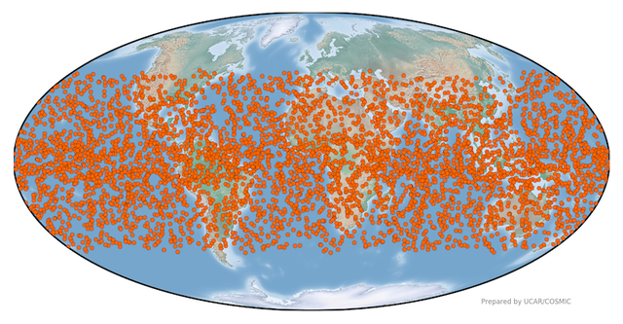
New era for GNSS-RO
The successful launch of FORMOSAT-7/COSMIC-2 marks a new era of RO for operational NWP, which will have profound impacts on all activities related to atmospheric sounding.
NOAA is strengthening support for COSMIC2, recognizing its significance, transiting GNSS RO from research to operations for weather forecast.
COSMIC2, together with Metop/Meotop SG, is expected to become an on-orbit reference for atmospheric sounding, establishing consistency for all measurements.
It is important to ensure the consistency, accuracy, precision of the measurements with well understood uncertainties. NOAA ICVS system is critical important for the purpose.
COSMIC2
October 1, 2019

Slide 5
NOAA ICVS: Background
NOAA ICVS system is a well known near real-time performance monitoring for all NOAA environmental satellites and instruments
Near real time and long term instrument status, performance monitoring, and anomaly diagnosis
Near real time and long term level 1 data product quality monitoring
Provide real time support for sensor calibration activities
Provide rapid and preliminary estimate of satellite data impact in NWP applications
Ensure the integrity of the climate data records from all satellite instruments

Slide 6
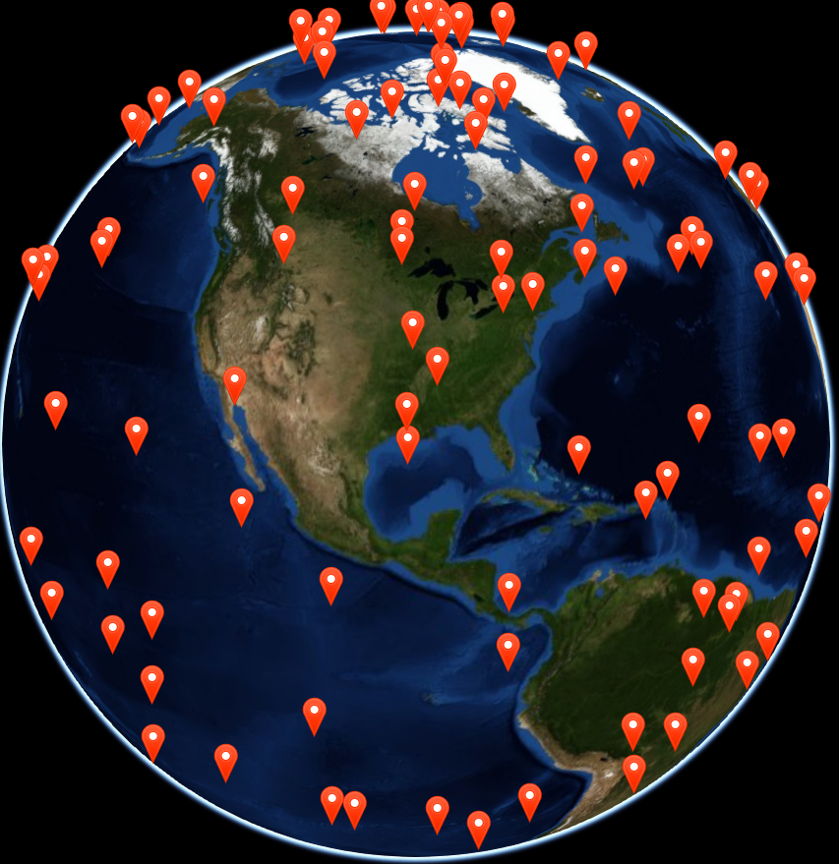
NOAA ICVS: Extension
GNSS RO ICVS is a natural extension of the NOAA ICVS system, with more dynamic and interactive capabilities. The system includes:
Monitoring RO product parameters and instrument performance at all levels.
Routine comparison of atmospheric profiles with other satellite observations and retrievals including microwave, and infrared.
Routine comparison of profiles with those from Radiosondes.
Dynamic web interface with many capabilities.
Long-term monitoring of the parameters.
WebGL Earth interactive plots

Slide 7
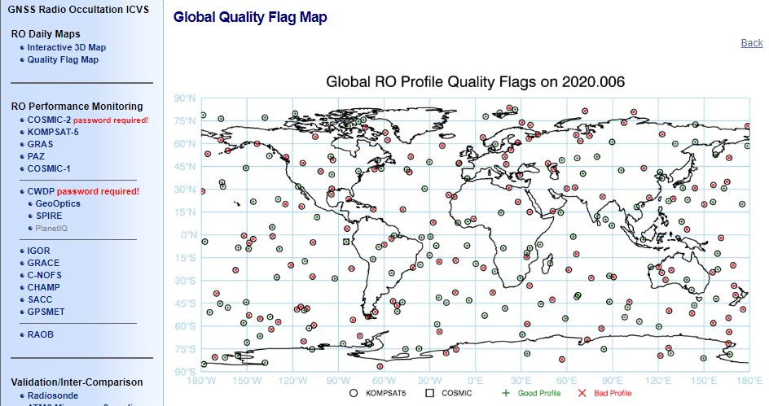
NOAA ICVS for RO: Introduction
Currently, RO data from 12 publicly available missions are included, from GPSMET collected in 1995 to COSMIC2 data in 2019.
RO data producer: UCAR, ROMSAF, ROPP and STAR (under testing).
References: Weather Model, reanalysis, other RO data, Radiosonde

Slide 8
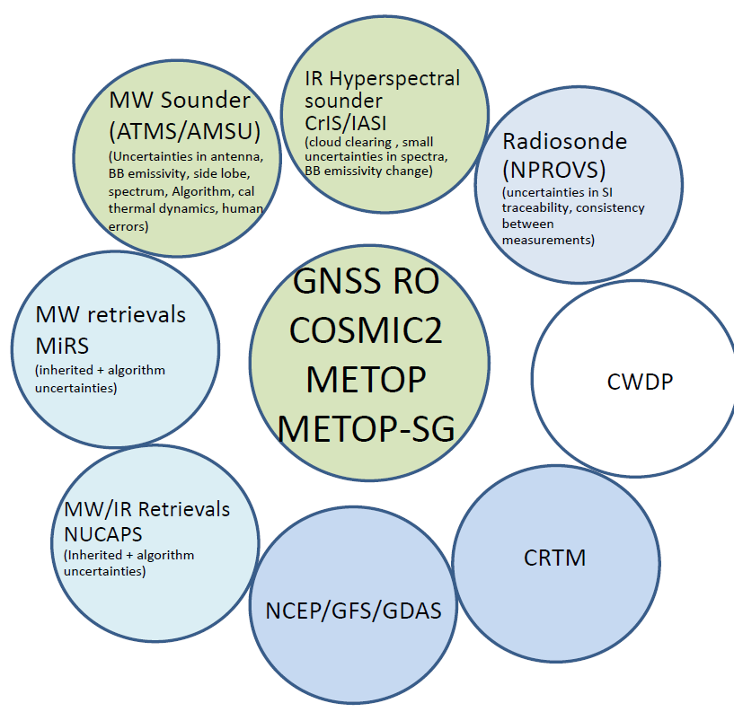
NOAA ICVS for RO: References
Working online
  NCEP/GFS/GDAS
  Model reanalysis, era/merra/nra/jra
Working offline, will eventually transit online
  GNSS-RO inter-comparison
  Radiosonde
  Retrievals: MiRS/NUCAPS
  MW sounder: ATMS/AMSU-A
  IR sounder: CrIS/AIRS/IASI

Slide 9
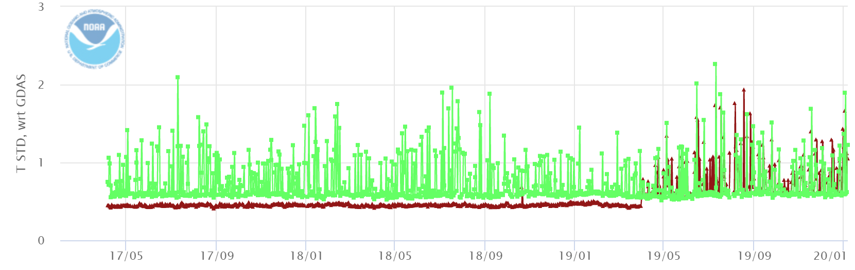
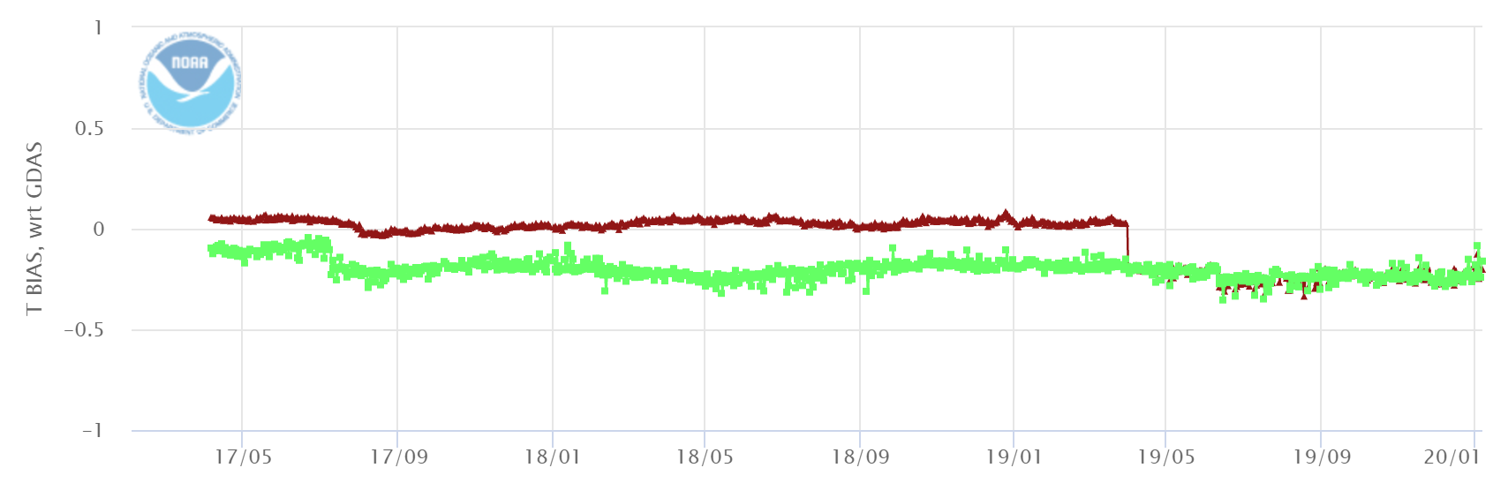
NOAA ICVS for RO: Model comparison
ROM SAF processed MetopA w.r.t. ERA5
Get a big picture of RO behavior.
Help users to locate suspicious profiles quickly, and easily deep dive to find the source.
Mean bias
STD
Brown line before 2019-03-31 is from ROM SAF CDR, after 2019-03-31 is from ROM SAF NRT;
Green line is from GDAS.

Slide 10
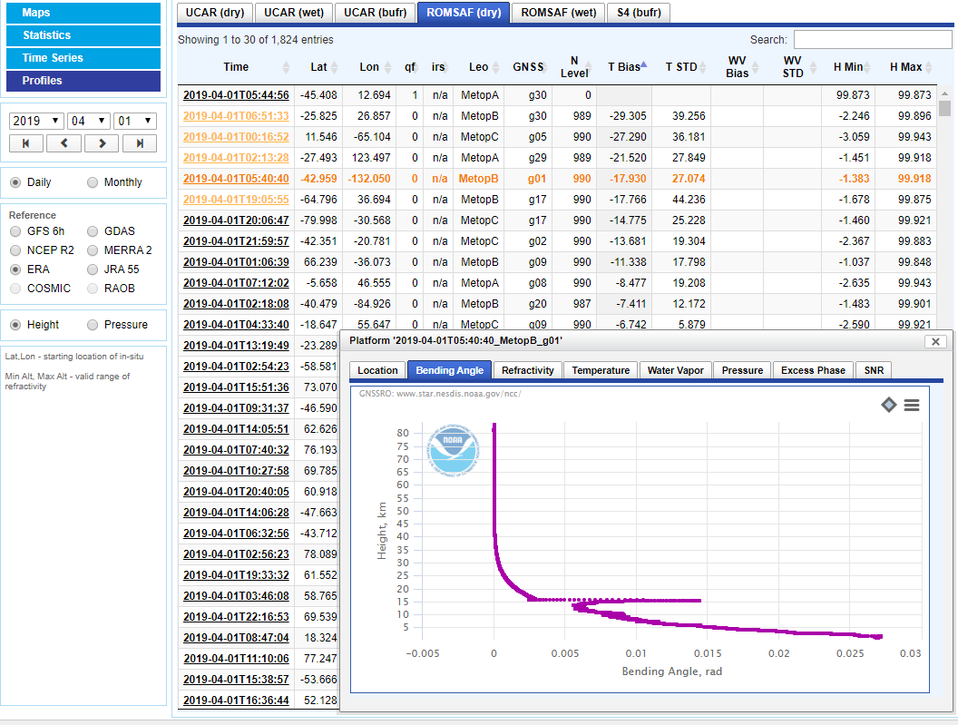
By sorting the title of each columns, uses is capable to find the interesting individual profiles and display the whole profile.

Slide 11
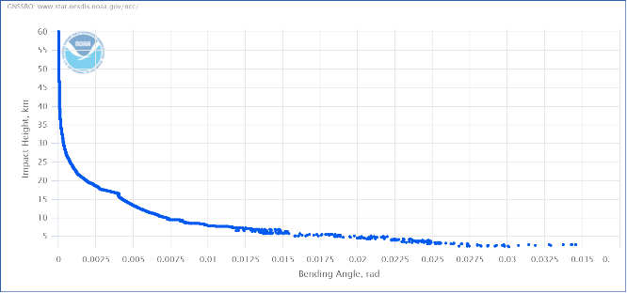
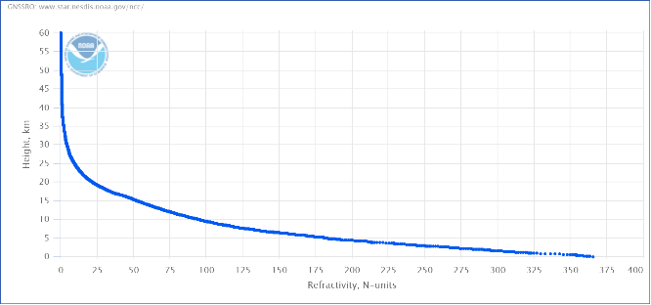
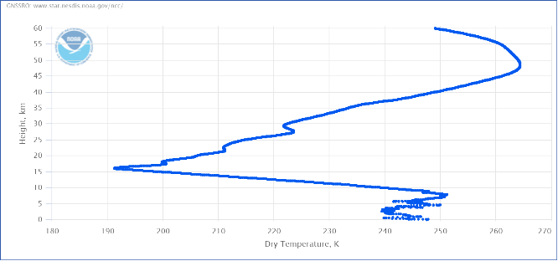
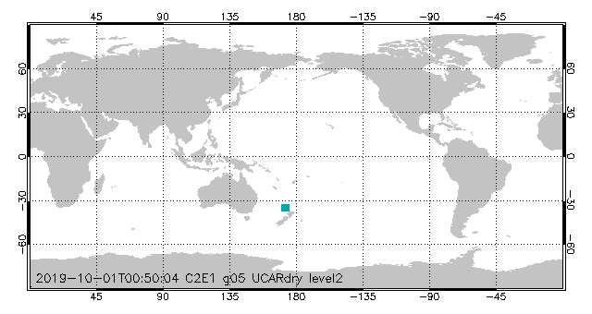
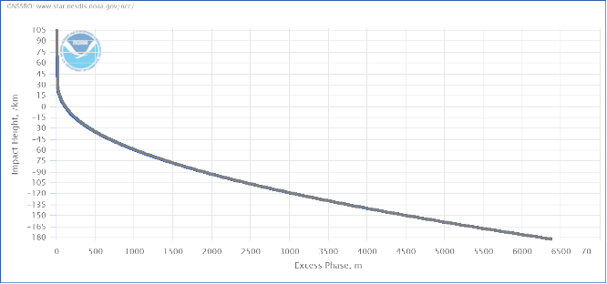
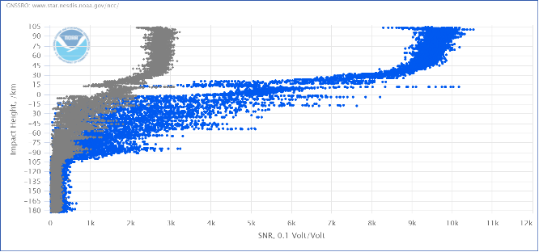
Individual profiles are monitored for L1b (excess phase, signal to noise ratio) and L2 (bending angle, refractivity, dry temperature, temperature, water vapor pressure, pressure).
Bending angle
Refractivity
Temperature
Excess phase (L1/LS)
Signal to noise ratio (L1/L2)
Map

Slide 12
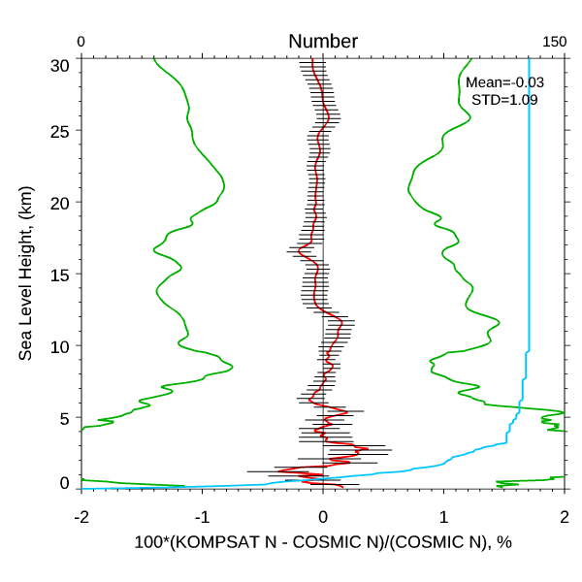
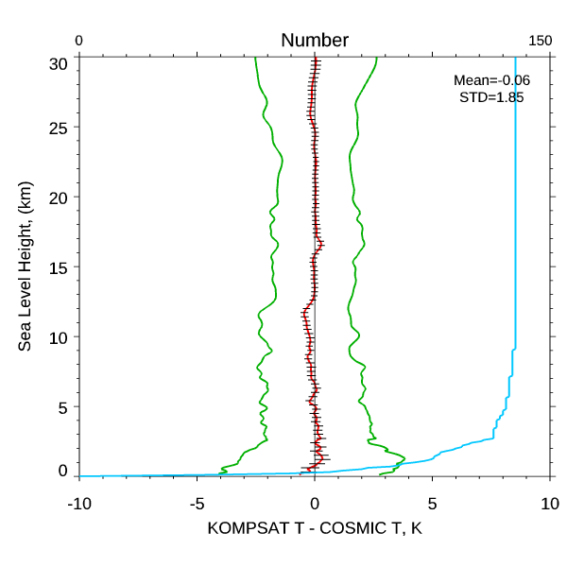
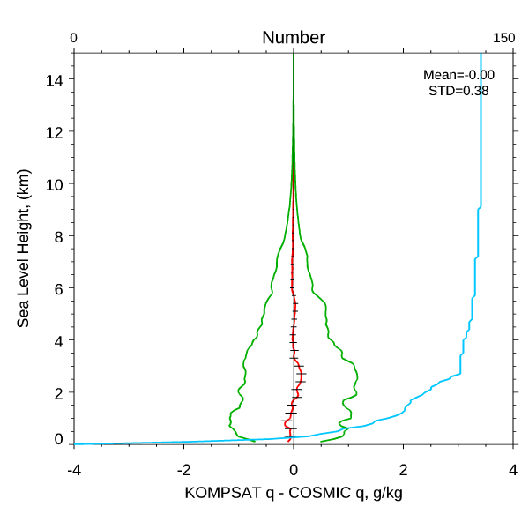
NOAA ICVS for RO: RO inter-comparison
Colocation RO inter-comparison cross platform
One-to-one RO inter-comparison cross center
Fractional refractivity diff
Temperature diff
Specific Humidity diff
UCAR KOMPSAT5 vs. UCAR COSMIC

Slide 13
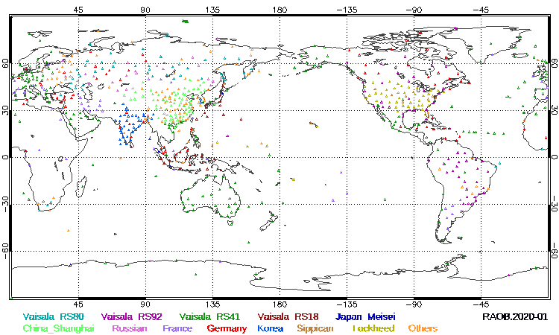
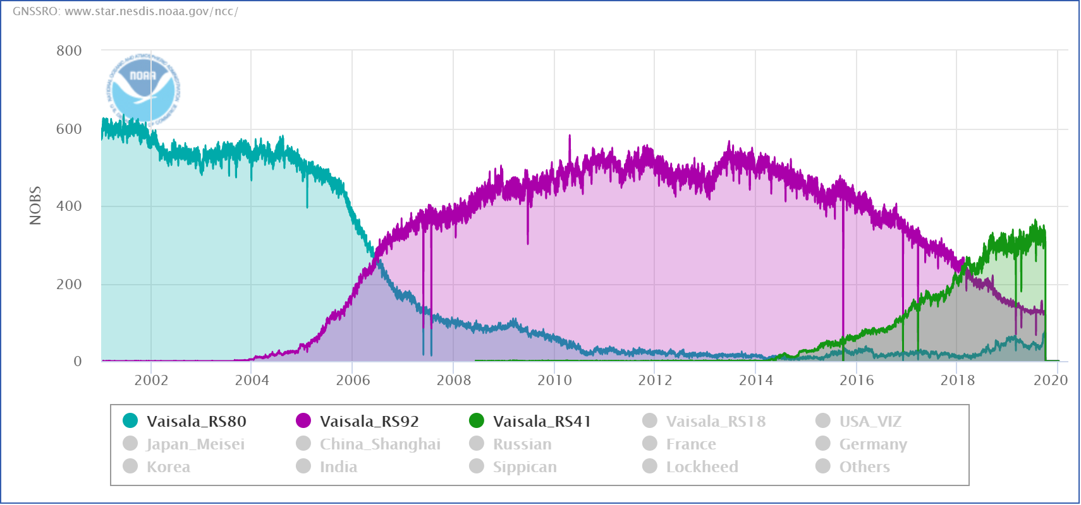
NOAA ICVS for RO: RAOB comparison
RAOB distribution in Jan 2020
There are over 15 radiosonde instrument types.
Vaisala RS80 and RS92 used to be the reliable reference.
Staring from 2018, Vaisala RS41 exceed RS80/92.

Slide 14
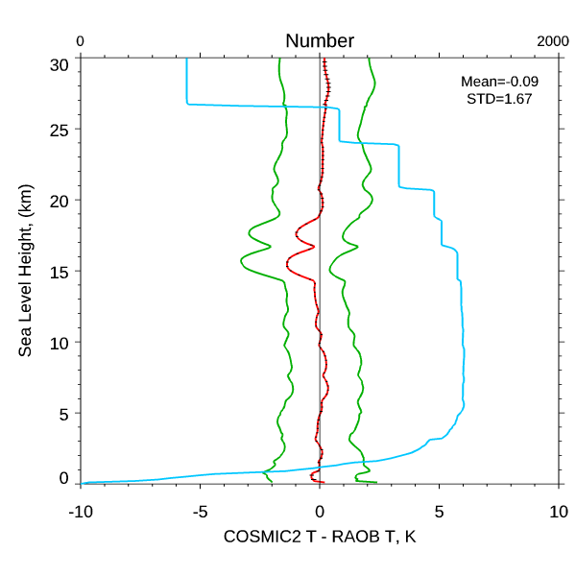
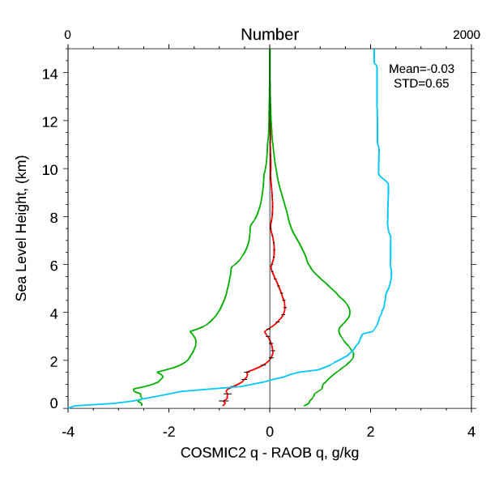
NOAA ICVS for RO: RAOB comparison
Temperature differences
Specific Humidity differences
UCAR COSMIC2 vs. Vaisala RS41

Slide 15
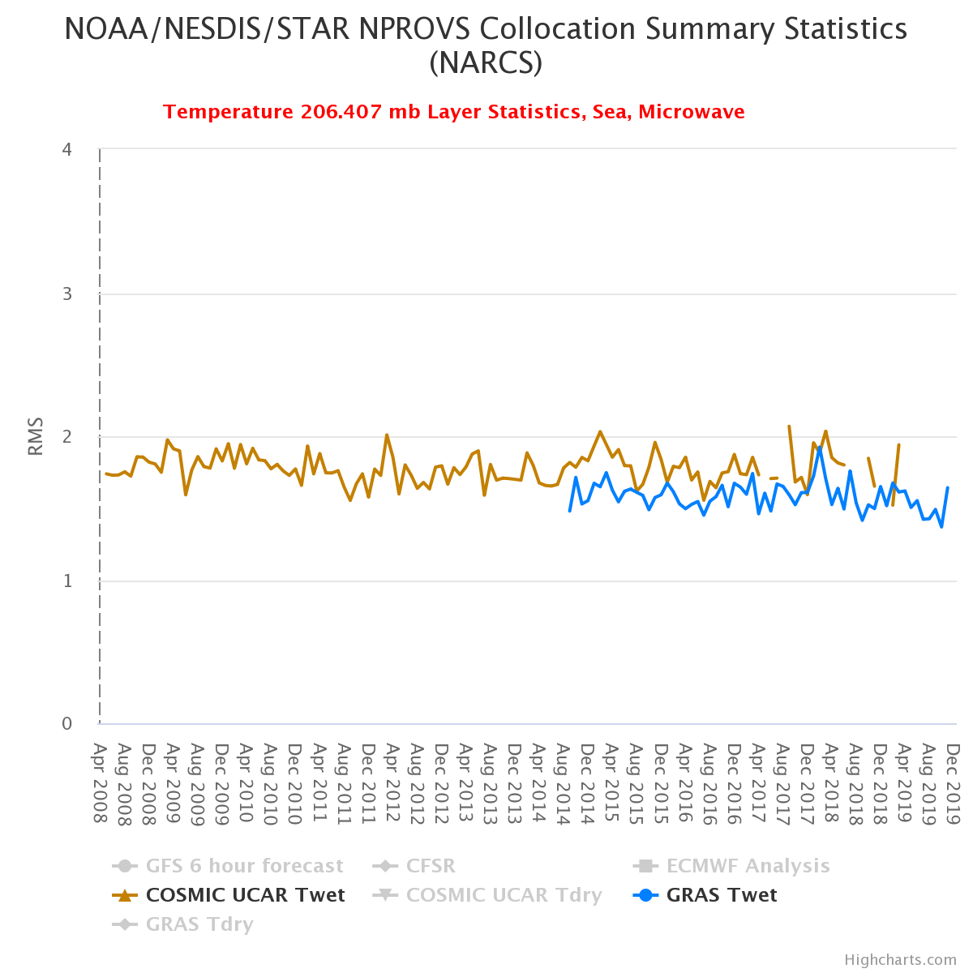
NOAA ICVS for RO: RAOB comparison

Slide 16
NOAA ICVS for RO: MW comparison against RO
Algorithm change
Bias between ATMS and RO are routinely monitored; anomalies are investigated

Slide 17
NOAA ICVS for RO: MW comparison using RO for double difference
SNPP/NOAA-20 ATMS CH10 BT bias relative to RO simulated
CH 10 BT double difference (NOAA20-SNPP)
NOAA-20/ATMS early orbit bias due to calibration issues
Use RO-CRTM for double differencing to study biases between ATMS on SNPP and NOAA-20

Slide 18
Summary
NOAA STAR has developed a comprehensive integrated cal/val system (ICVS) to ensure the data quality of all NOAA satellite measurements, including Radio Occultation, for which COSMIC2 will play an important role in many areas.
This web-based system supports instrument performance monitoring, inter-comparisons with other independent measurements, and data assimilation in collaboration with data users.
Radio occultation is becoming increasingly important for numerical weather prediction, which requires similar level of support as for microwave and infrared sounding instruments.
The next step is to develop low level processing capabilities & incorporate it in ICVS (Level 0/RDR->Level 1/SDR->Level 2/EDR) to support full chain processing validation.
We are committed to support ICVS for our community users and partners. Ongoing development and improvements are based on user’s needs and feedback

Slide 19
Acknowledgements
Thanks to the COSMIC2 team for the hard work, including NSPO, UCAR, NOAA/NESDIS/OPPA, NOAA/NESDIS/STAR, JCSDA, USAF, and others
Thanks to EUMETSAT, ROM SAF for collaboration and technical assistance
Special thanks to Rich Ullman of NOAA/NESDIS/OPPA for initiating the COSMIC2 cal/val project at STAR

