Slide 1
RO Group Meeting
Erin Lynch

Slide 2
Statement of work
Worked with NCEI to prepare the Submission Agreement for archiving the CWDP data from both the vendors and UCAR. Prepared the CWDP data from both the vendors and UCAR for transfer to NCEI.
Worked on RO and IR intercomparisons using the CRTM to simulate IR brightness temperatures from RO retrievals. Verified the radiometric consistency between S-NPP CrIS Side-1 and Side-2 and that between Metop-B IASI and Metop-C IASI. Presented results and the AMS Annual Meeting 2020 in a talk entitled ” Intercomparison of Hyperspectral Infrared Sounders with Simulated Radiances from GNSS-RO Inputs”.
Helped to verify requirements for the CWDP operational data purchase and contributed to the drafting of the Statement of Need.
Worked with Dr. Kamila Kabo-bah from the University of Energy and Natural Resources in Ghana on a pre-proposal entitled “Calibration and Validation of Satellite Measurements for Numerical Weather Prediction in Ghana” for USAID funding.
Presented the poster entitled “COSMIC-2 Data for Atmospheric Soundings” at the JPSS GOES Proving Ground and Risk Reduction Meeting to let users know that the validated COSMIC-2 data is available for use.
Prepared the Data Delivery appendix of the CWDP Round 2 Report and helped to prepare the final draft of the report.

Slide 3
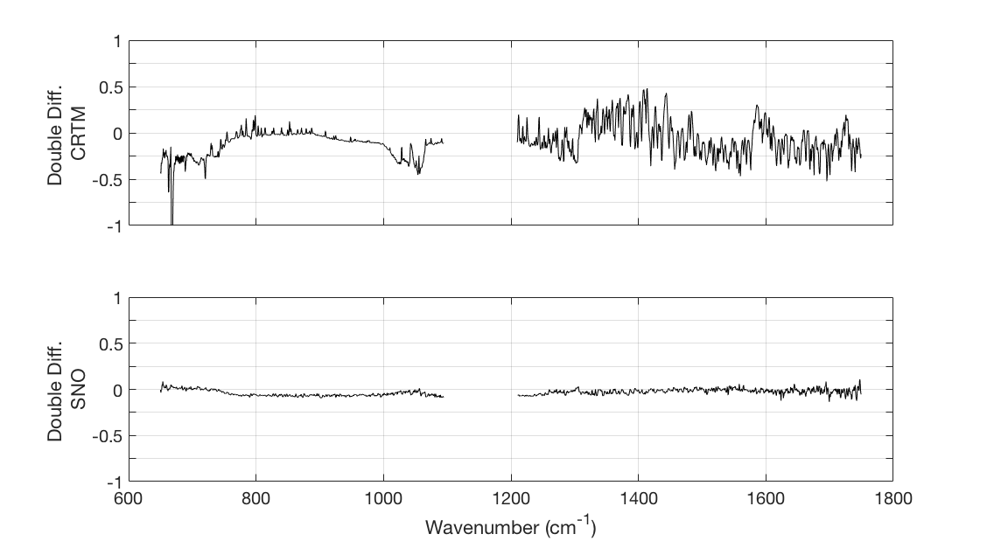
Important Results
MetOp-B GRAS wetPrf
Comparison between observed brightness temperatures and simulated brightness temperatures from a radiative transfer model
RO data provides the temperature and water vapor inputs with additional data provided by ECMWF reanalysis
Double difference taken to remove transfer and compare IR Sounders directly to one another
Suomi NPP CrIS Side-2
Agrees with S-NPP CrIS Side-1
Intercomparison with CRTM simulated BT with MetOp-B GRAS profiles as input:
0.1 K in LW
0.25 K in MW
Intercomparison with MetOp-B IASI SNOs:
Within 0.05K for the LW and MW channels
CRTM Simulated
Brightness Temperatures
O-B Bias
Double
Difference
O-B Bias
IR Sounder #1
IR Sounder #2
Mean Bias: (BT_{obs} – BT_{CRTM})
Double differences: Side-2 – Side-1
CRTM with MetOp-B GRAS input as transfer
Standard Deviation
SNOs with MetOp-B IASI as transfer
Double Difference: (BT_{obs} – BT_{CRTM})_{Side-2} – (BT_{obs} – BT_{CRTM}) _{Side-1}

Slide 4
Upcoming Publications
Co-author of ”Simultaneous Radio Occultation for Inter-satellite Comparison of Bending Angles towards More Accurate Atmospheric Sounding” by Cao et al.
to be submitted to the Journal of Atmospheric and Oceanic Technology

