Slide 1
Statement of Work
L2 band preprocessing – Currently noise in the L2 band is causing large number of profiles to be flagged as ‘bad profiles. It is common. However, since L2 band is the secondary channel, in cases where L1 signal quality is good, L2 channel is highly smoothed, or even replaced with phase model. We need to figure out how to use available L2 data to increase the number of ‘good’ profiles.
Improve Quality Control – Current quality control uses just one criteria, the mean bending angle difference between L1 and L2 bands between 35 – 50 km. It can be improved by adding an additional constraint in the refractivity relative to climate model.
Initialization – Currently, using exponential extrapolation above 40 km. The result is sensitive to noise near 40 km in the retrieved bending angle, that can possibly introduce bias in the retrieved refractivity. Need to optimize the bending angle before initialization.

Slide 2
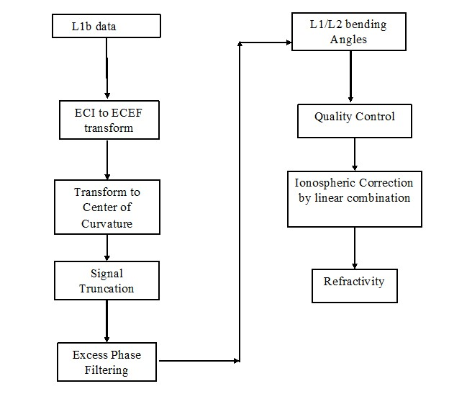
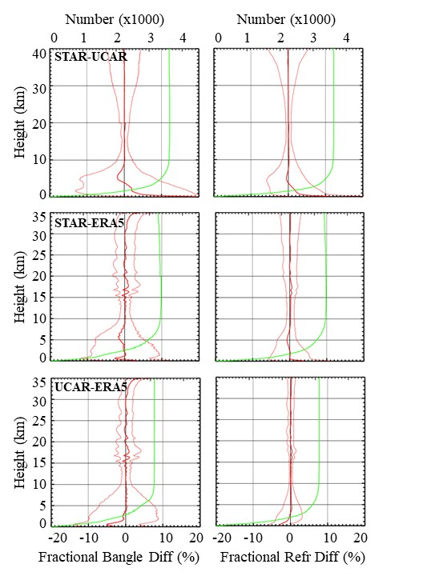
Current Work – Inversion of phase and SNR to bending angle and refractivity
Different steps used in the NOAA STAR inversion of geometry and phase data to bending angle and refractivity profiles
Intercomparison of Bending angles and Refractivities among STAR, UCAR and ERA5

Slide 3
Publication Expectation
Currently preparing manuscript for Remote Sensing titled ‘Inverting COSMIC-2 Phase Data to Bending Angle and Refractivity Profiles using the Full Spectrum Inversion Method’.

