Slide 1
Current work
Current efforts focus on evaluating performance of COSMIC-2
Temperature/water vapor comparison between RO and Radiosonde/MW/IR (MW/IR through CRTM)
Characterization of the COSMIC-2 performance in terms of penetration depth distribution, penetration depth as function of L1 SNR and BAL as a function of L1 SNR
Bending angle level evaluation
  Co-location evaluation
  O-B evaluation
Through all above works, evaluate the performance of COSMIC-2 from bending angle/refractivity level to temperature/humidity product level

Slide 2
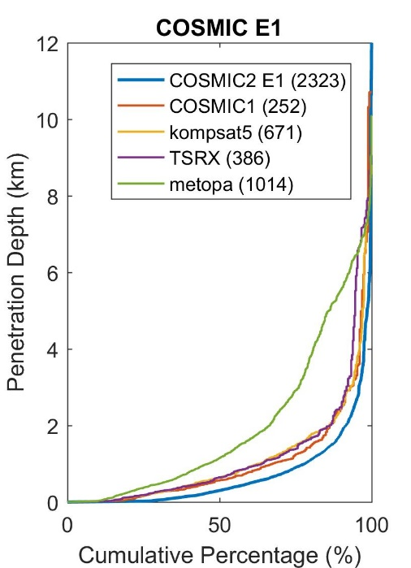
Some results

Slide 3
Papers we are working on
Characterization of GRUAN RS92 and GRUAN RS41 RAOB temperature biases using RO data
Inter-comparison paper
GeoOptics (?)

Slide 4
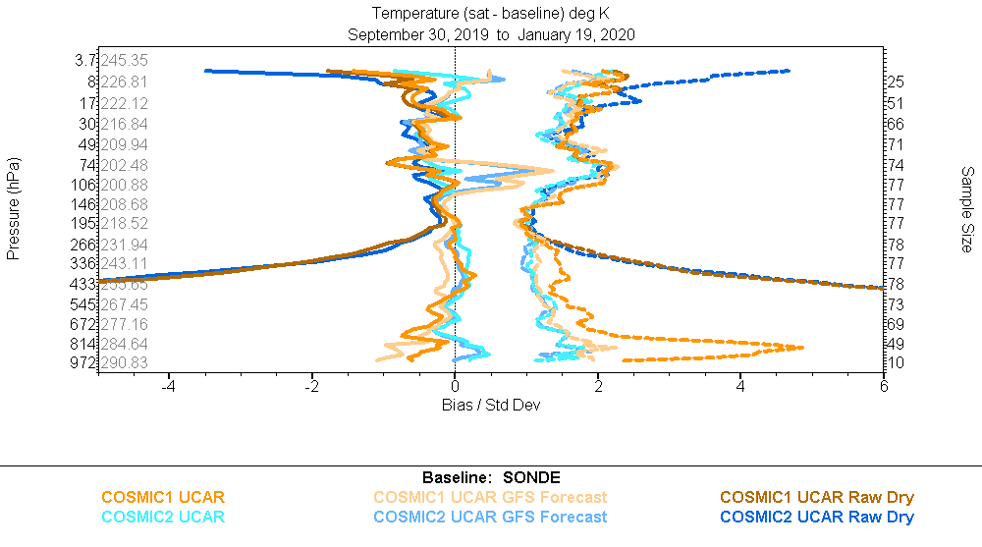
COSMIC-1 10/2018-12/2018
COSMIC-1 10/2019-12/2019
Tony’s Results
COSMIC-2 E1 10/2019-12/2019

Slide 5
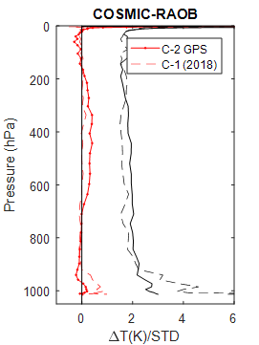
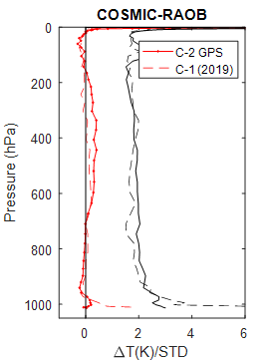
COSMIC-1 10/2018-12/2018
COSMIC-1 10/2019-12/2019
Tony’s Results
COSMIC-2 E1 10/2019-12/2019
All Six satellites of COSMIC-2

