Slide 1
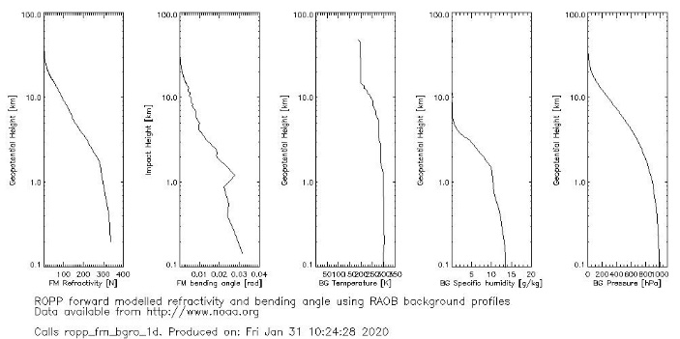
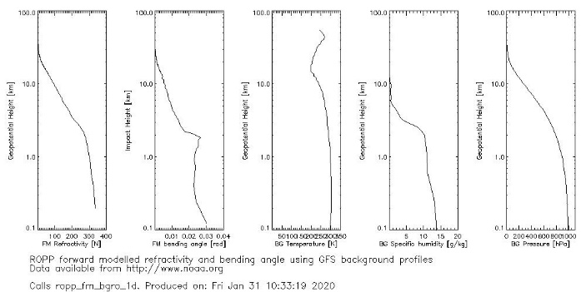
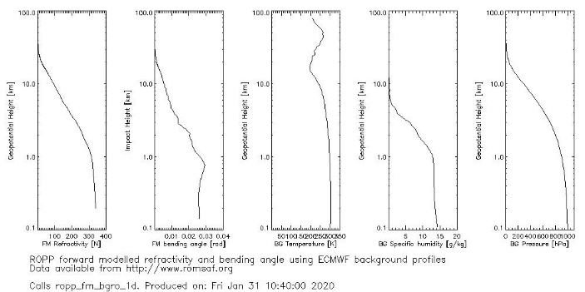
Statement of Work
Developing a dry temperature algorithm for FSI system
The algorithm has been integrated into FSI system
Developed a procedures to transform GFS forecast to ROPP forward model background
Developed a procedures to transform RAOB to ROPP forward model background
Compared bending angle and refractivity of ROPP forward model output with col-located RAOB, GFS, and ECMWF as input
RAOB
GFS
ECMWF

Slide 2
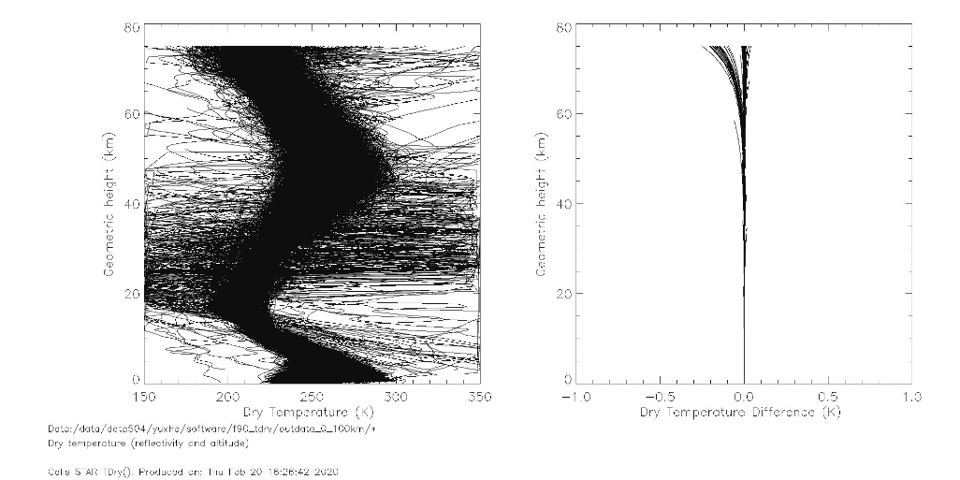
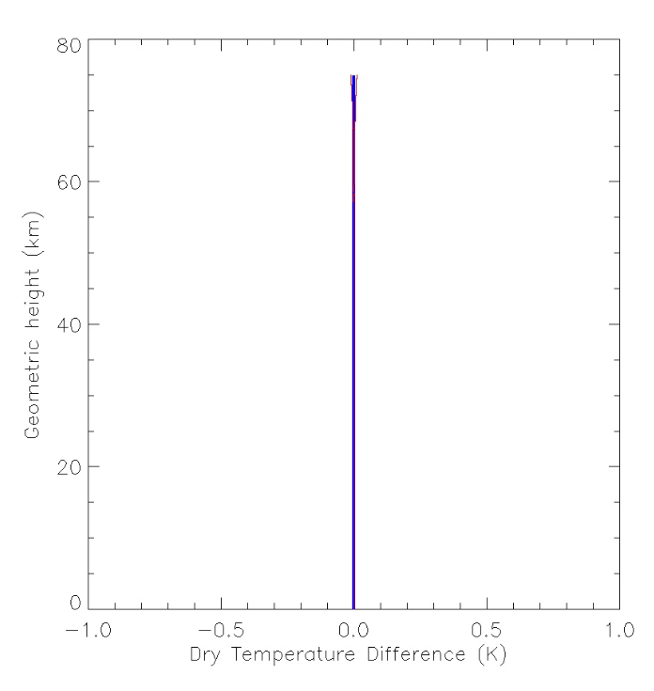
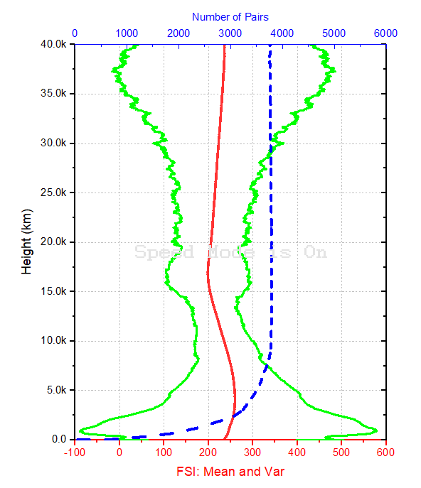
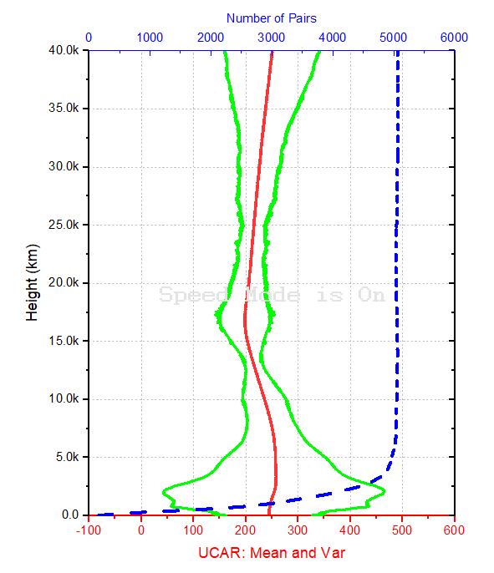
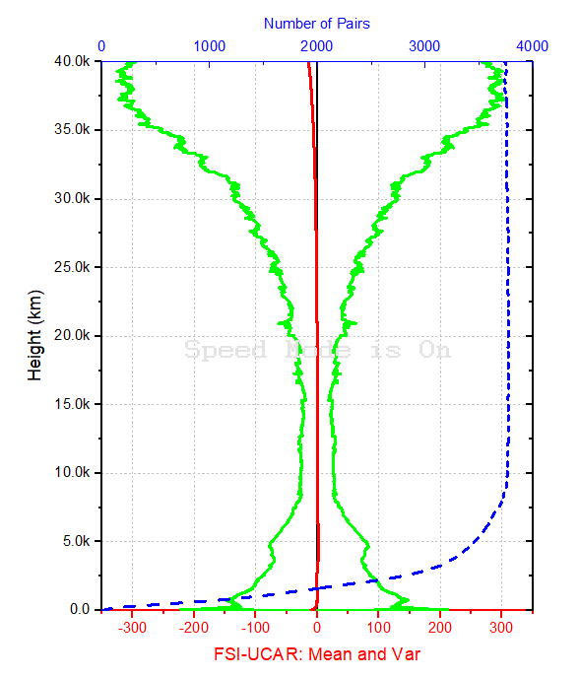
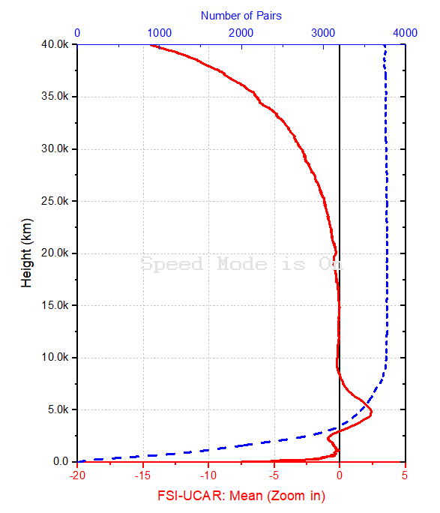
Current Work: Developing a dry temperature algorithm
Developed a dry temperature and dry press algorithm and tested
Integrated the algorithm into FSI system and compared with UCAR’s products
The Following Functions will be Replaced by STAR FSI
STAR Tdry will be integrate to FSI
Level 1A data
ROPP_OCC (FULL)
A: Tdry
Bending Angle(FULL)
Refractivity
Alt
STAR Dry Temperature
B: Tdry
Ref(NONFULL)
ROPP_OCC (NONFULL)
C: Tdry
Bending Angle(NONFULL)
Refractivity
Alt
STAR Dry Temperature
D: Tdry
Ref(NONFULL)

Slide 3
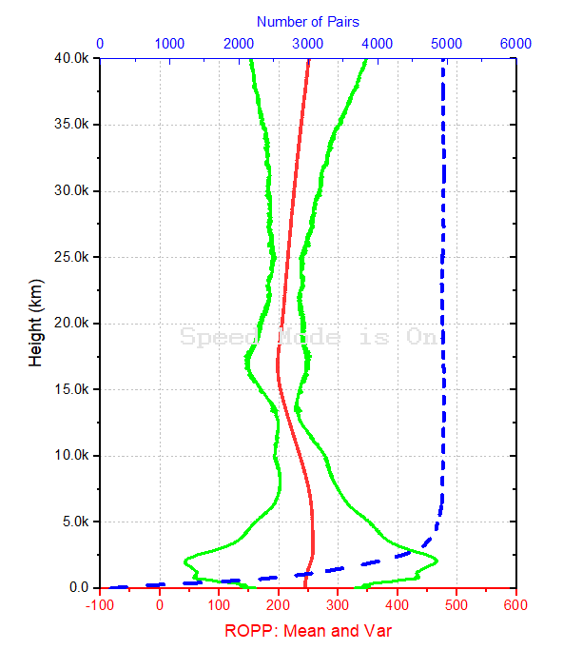
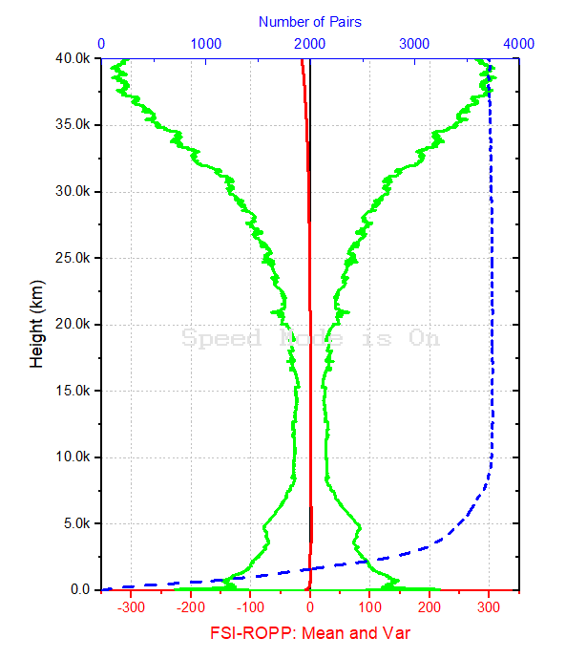
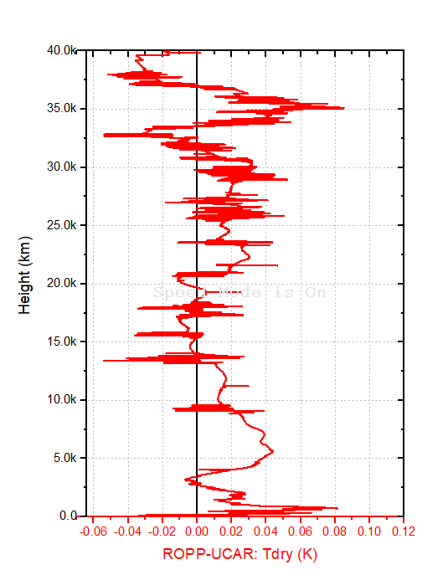
Further compared with ROPP’s products
The difference of ROPP with UCAR
The bending angle and refractivity needs to be further improved
Possible paper is about how to improve STAR FSI system

